Slide 1
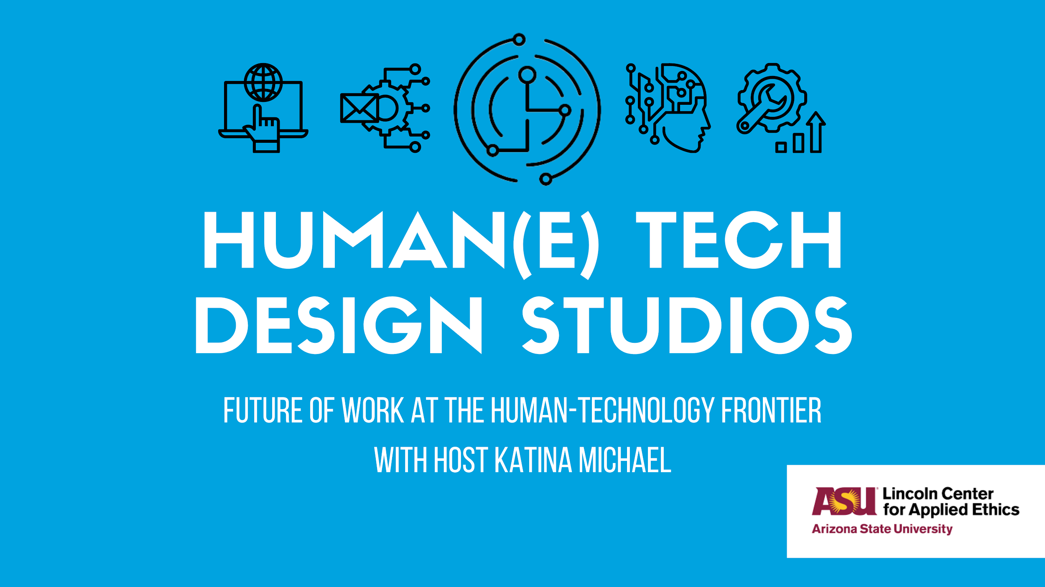

The Studio will begin momentarily.

Slide 3
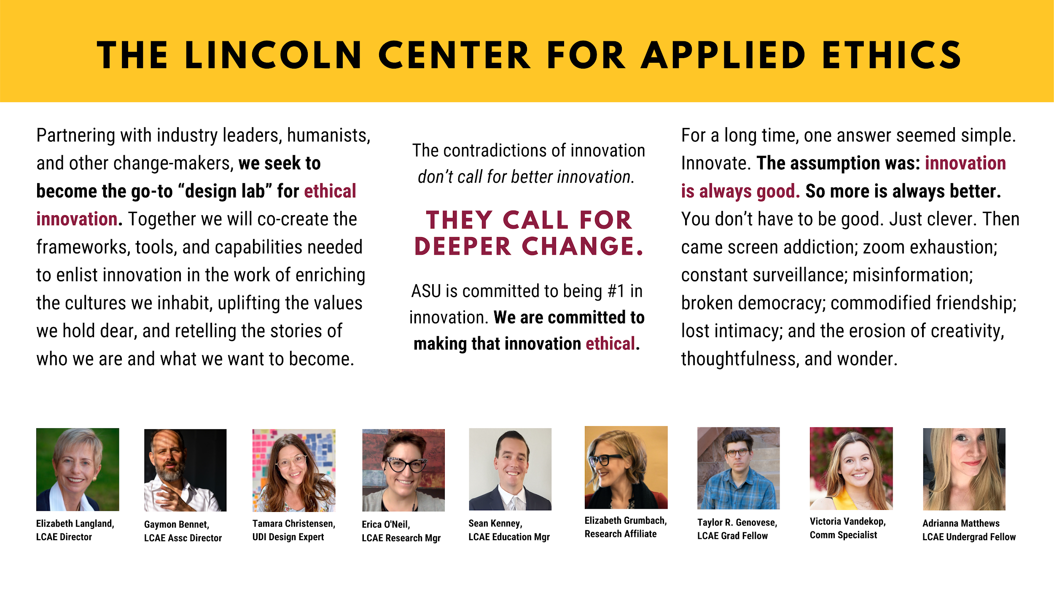

Notes:
(5 mins) - Elizabeth introduces macro ambitions, LCAE

Slide 4
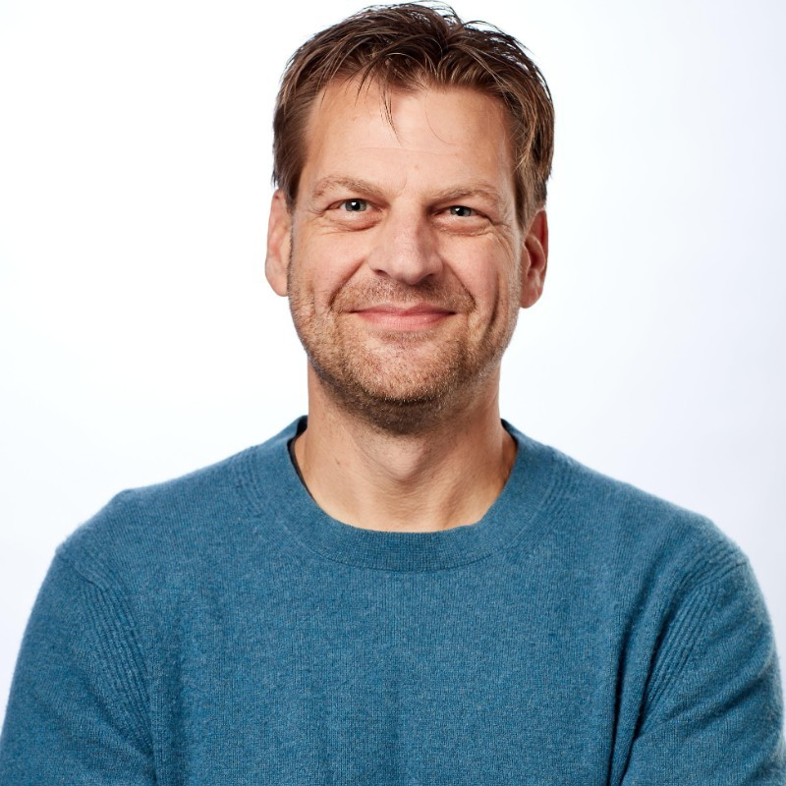


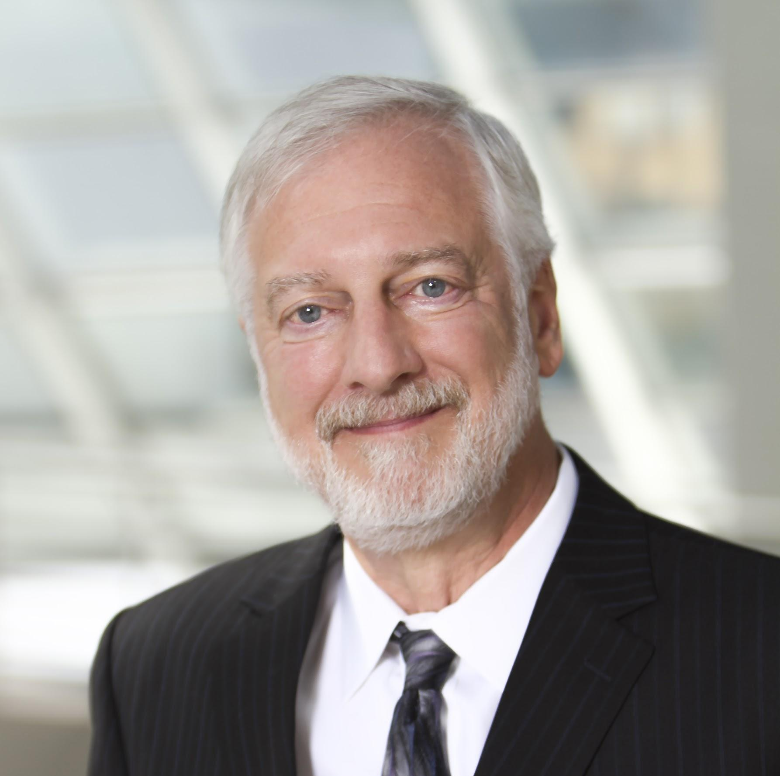
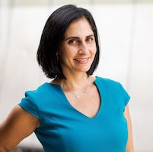
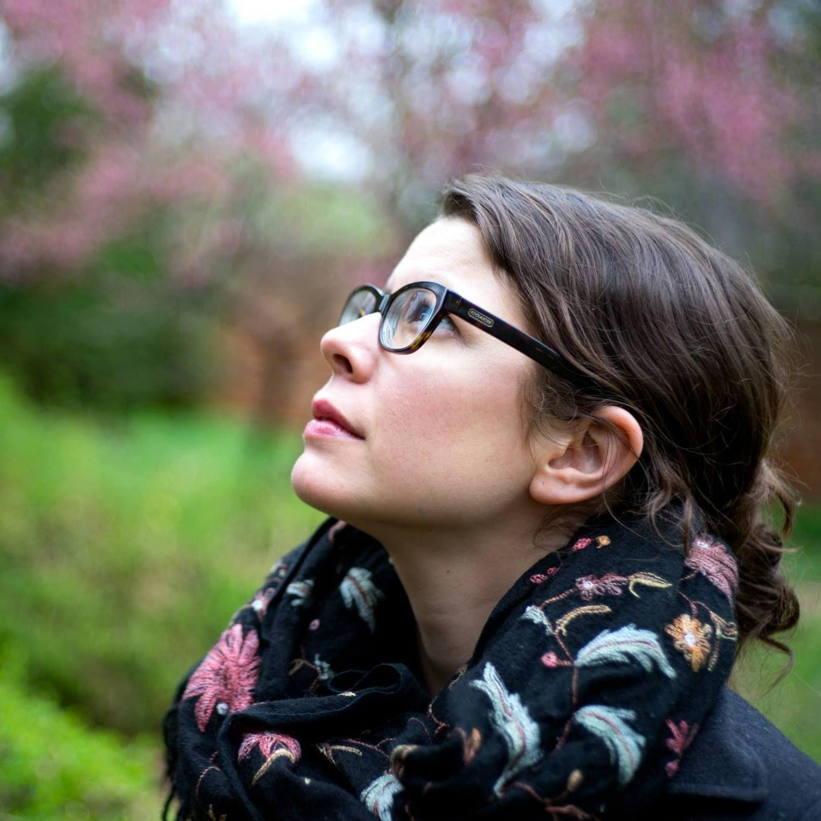
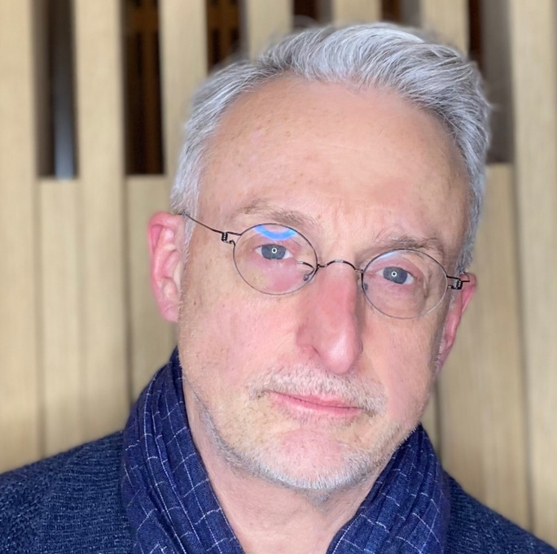
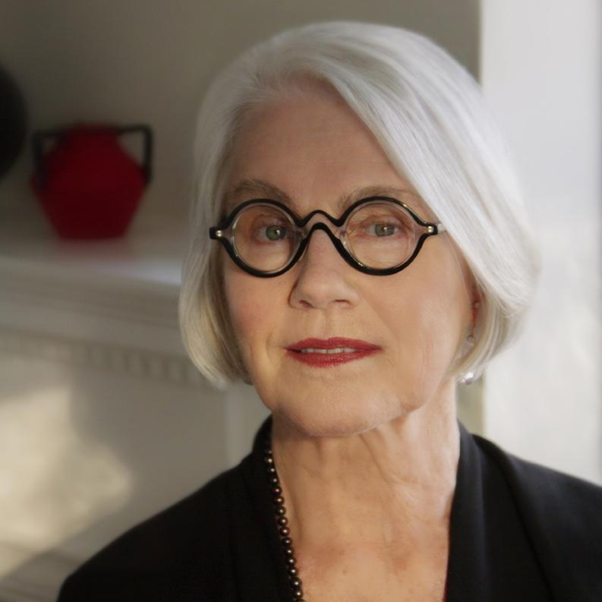
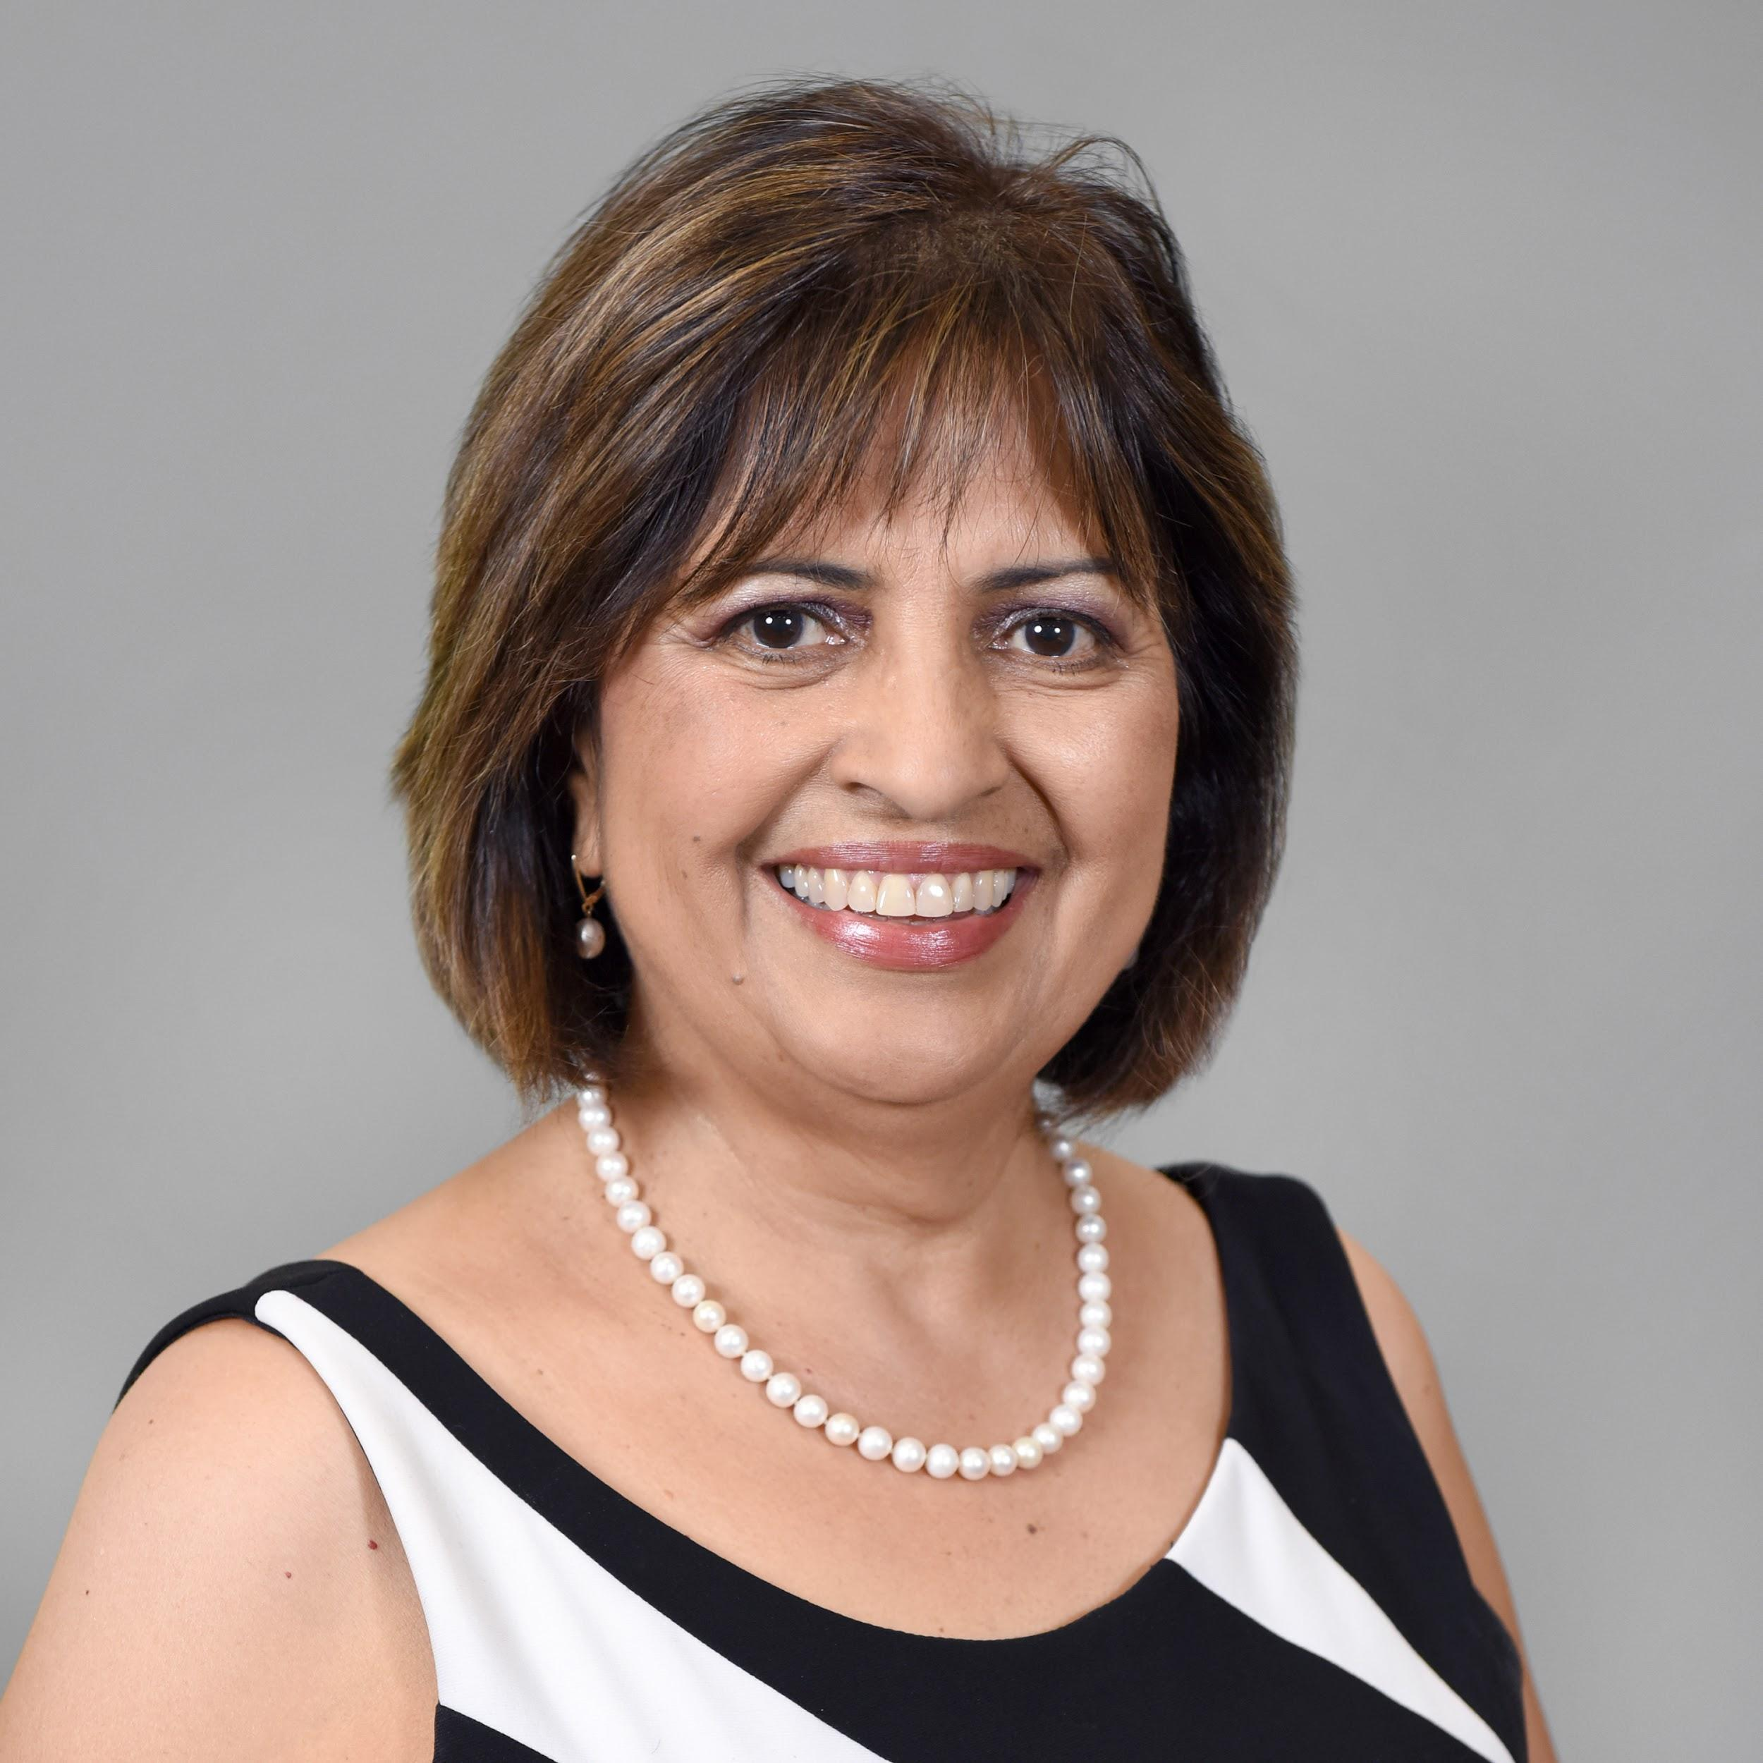
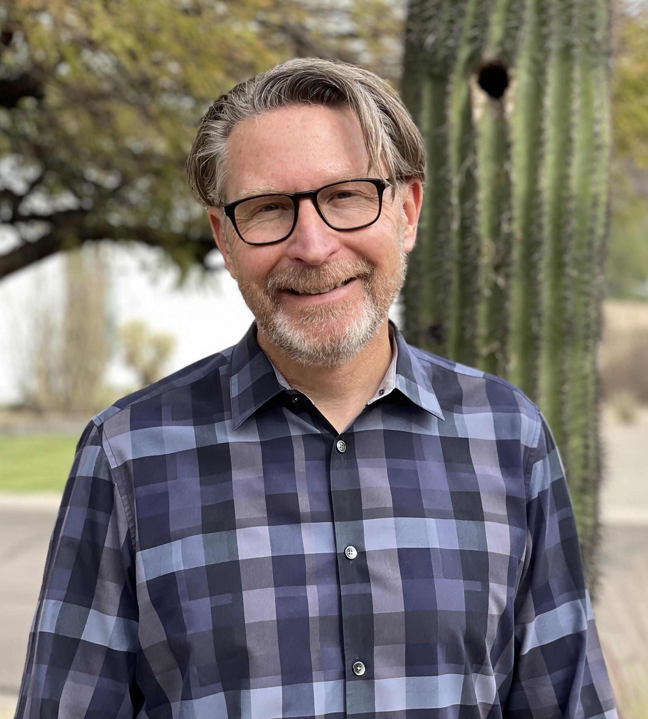
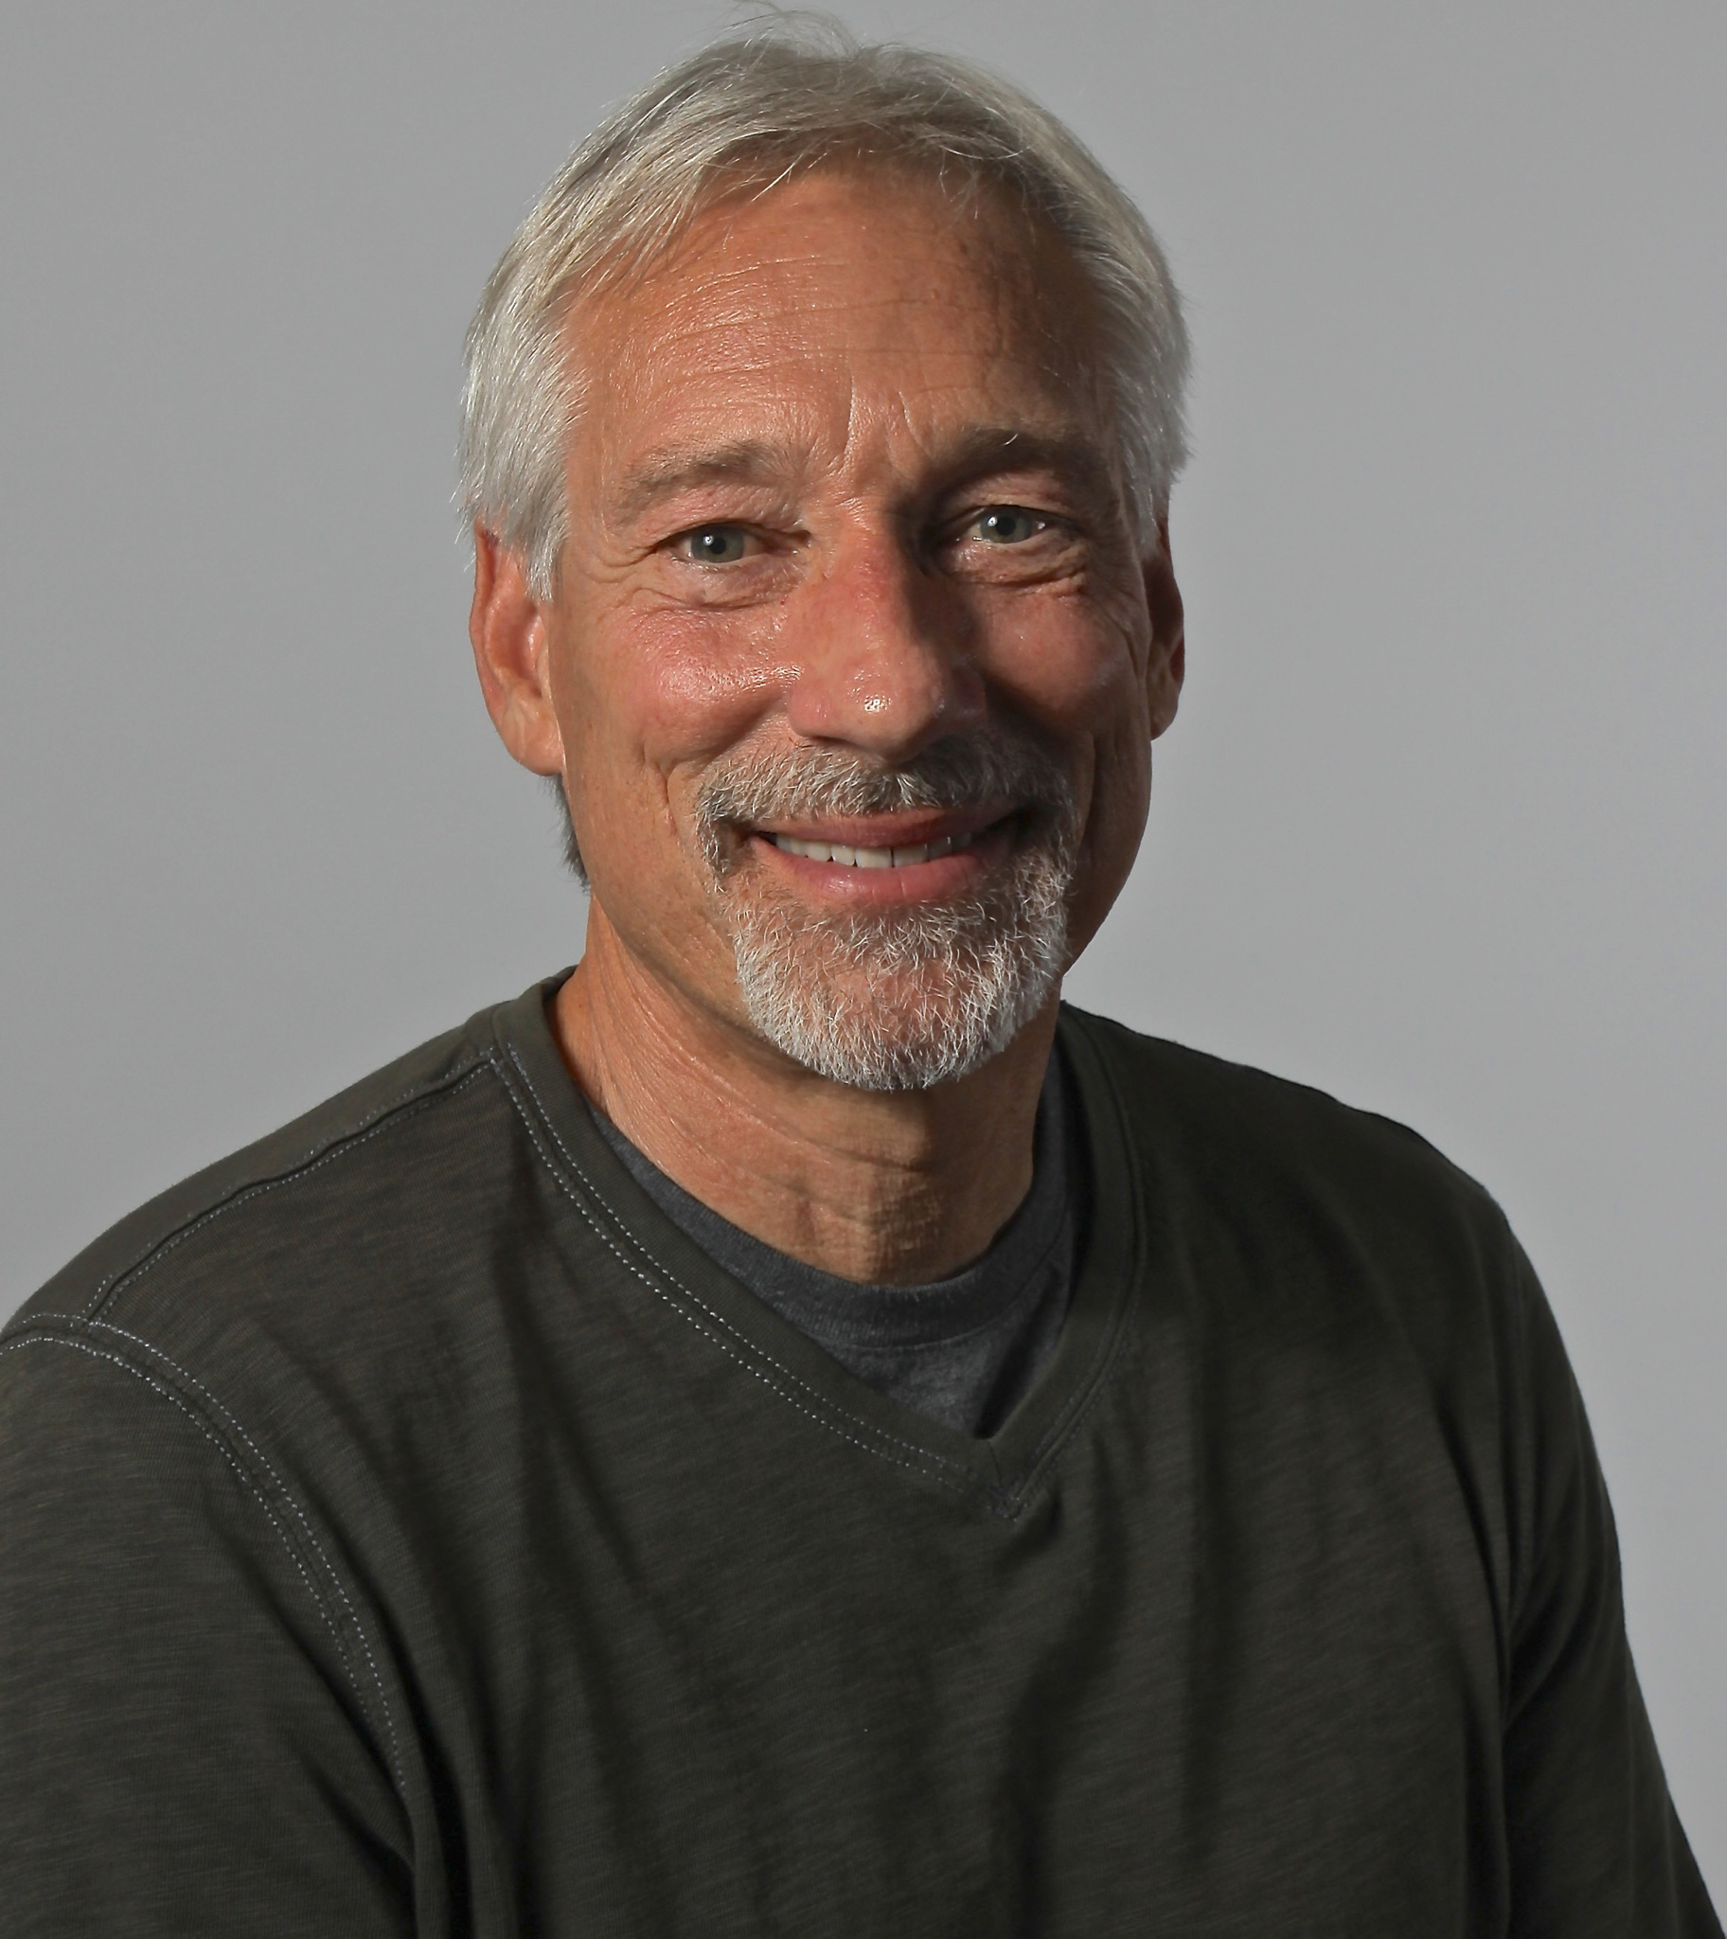
Please say Hello!
Teddy Zmrhal
Ayanna Thompson
Dédé Tetsubayashi
Nathan Shedroff
Marcel O'Gorman
Robert Newman
Radha Mistry
Pardis Mahdavi
Purdom Lindblad
David Kirkpatrick
Rosemarie Garland-Thomson
Jake Dunagan
Irasema Coronado
Jeffrey Cohen
Christina Boyles
Barry Brown
Ian Bogost

Slide 5
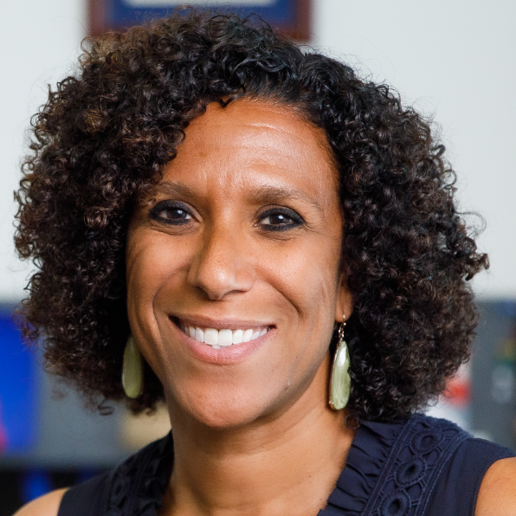
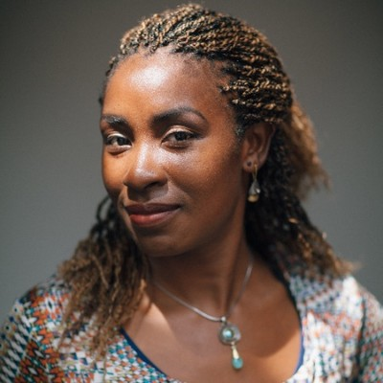
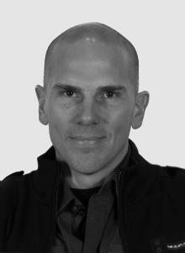

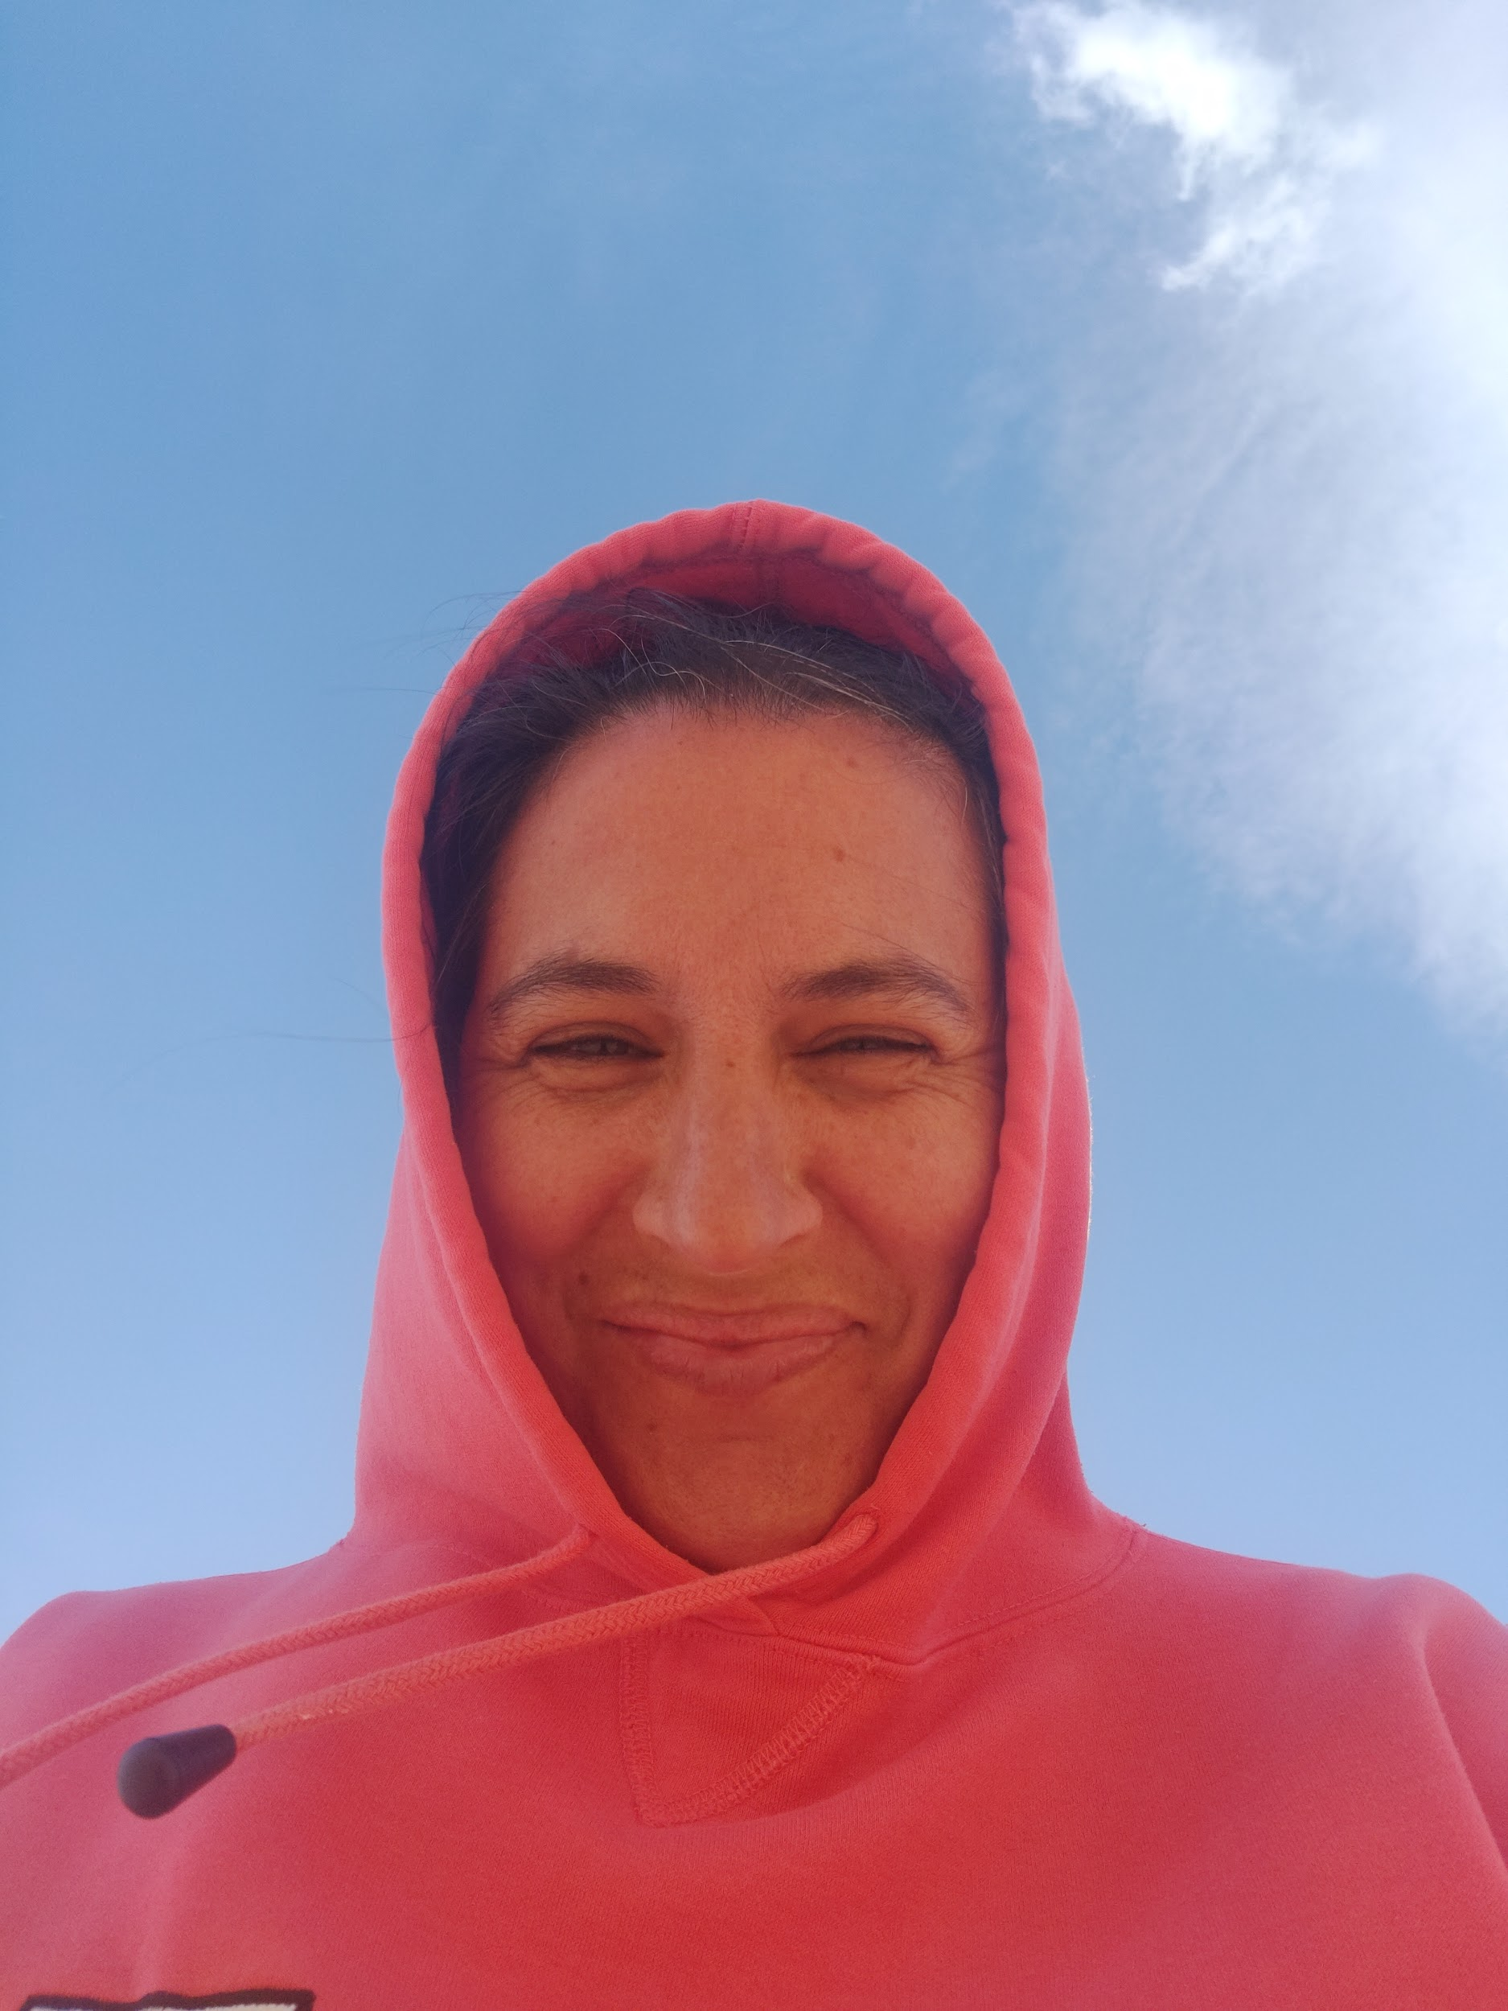
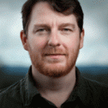
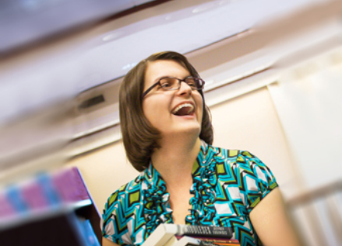
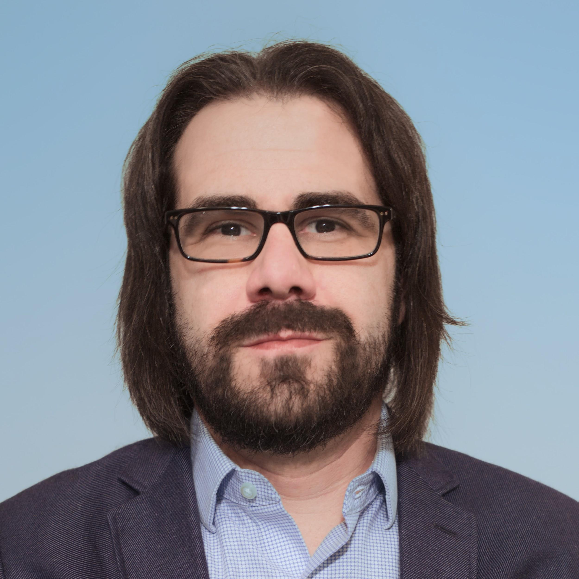
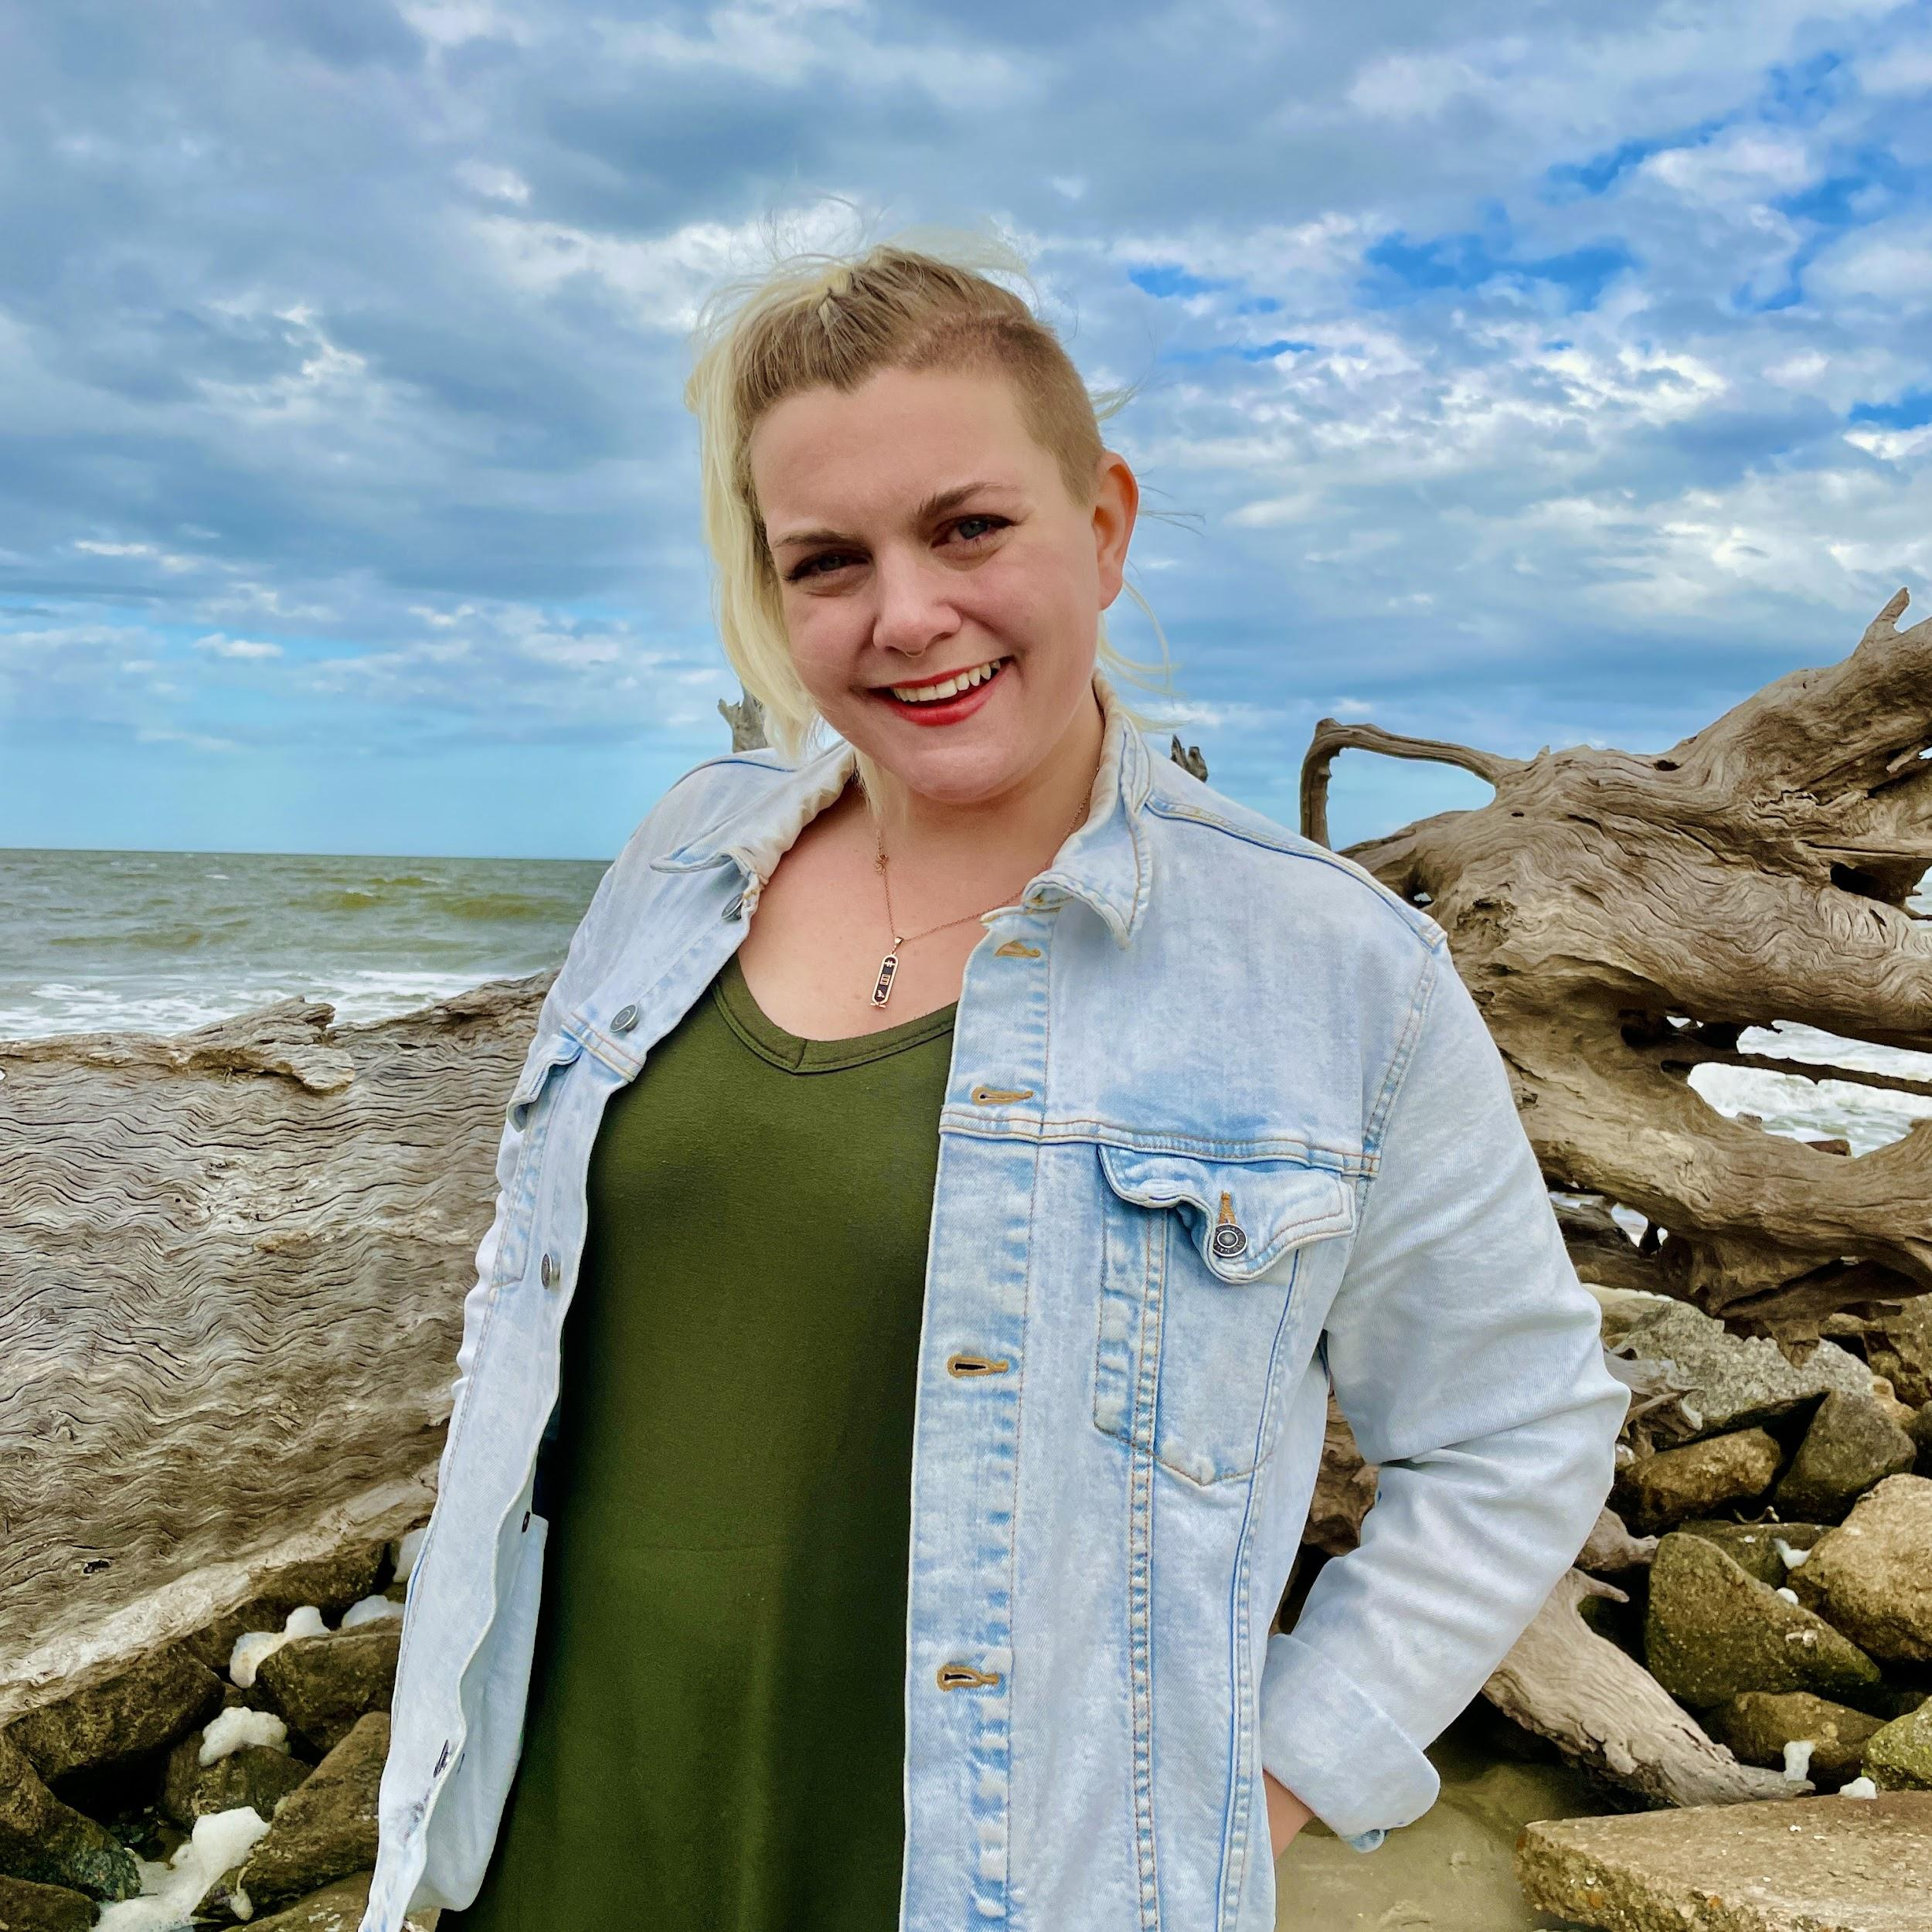
Please say Hello!
Teddy Zmrhal
Ayanna Thompson
Dédé Tetsubayashi
Nathan Shedroff
Marcel O'Gorman
Robert Newman
Radha Mistry
Katina Michael
Pardis Madhavi
Purdom Lindblad
David Kirkpatrick
Jake Dunagan
Irasema Coronado
Jeffrey Cohen
Christina Boyles
Barry Brown
Ian Bogost
Sam Ashlee

Slide 6
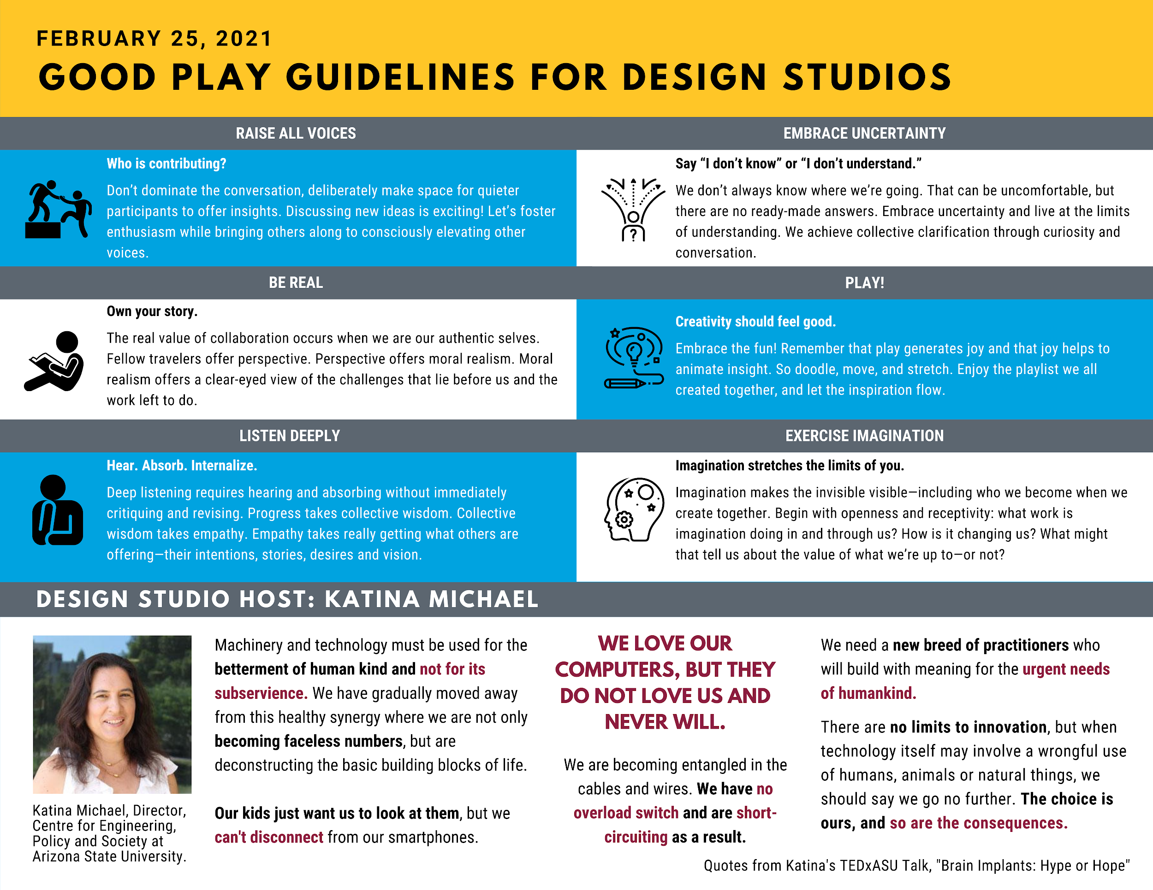
Host: Katina Michael

Slide 7

Our Studios

Slide 8
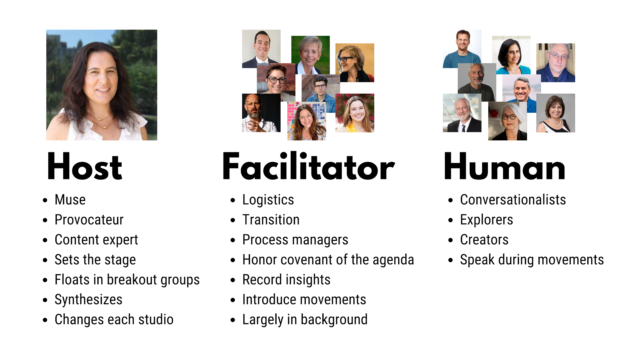

Slide 9
Prelude: 5 min
Movement 1: 20 min
Movement 2: 22 min
Break: 15 min
Movement 3: 22 min
Final Thoughts: 13 min
Design Studio
Agenda

Slide 10
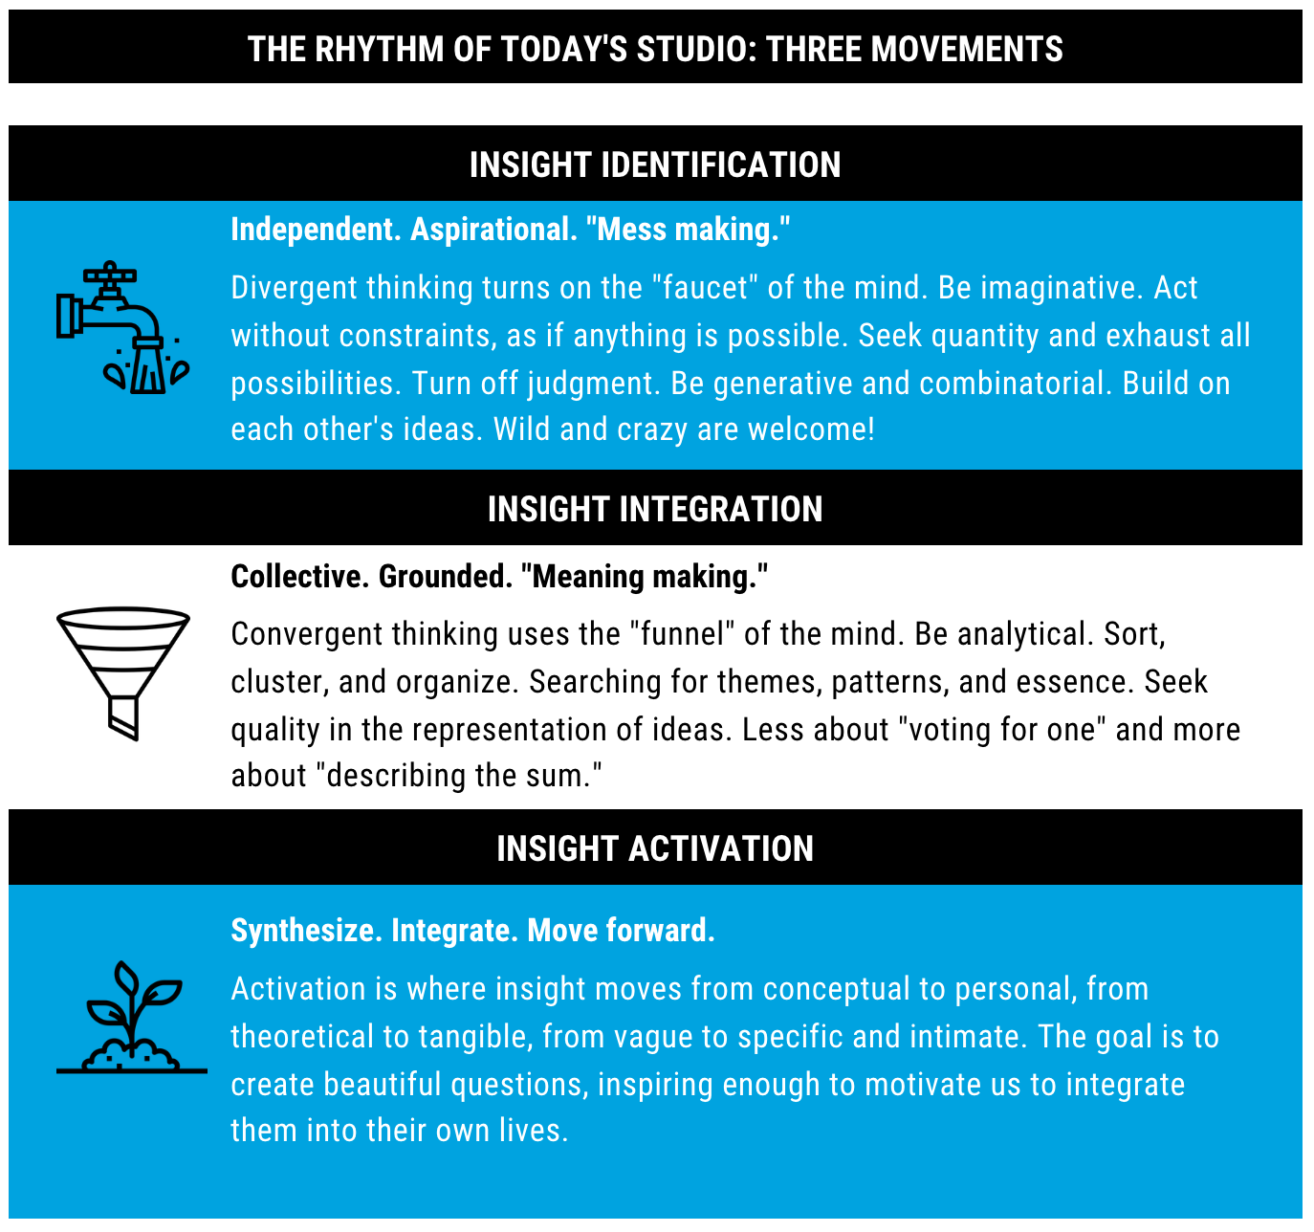

Slide 11
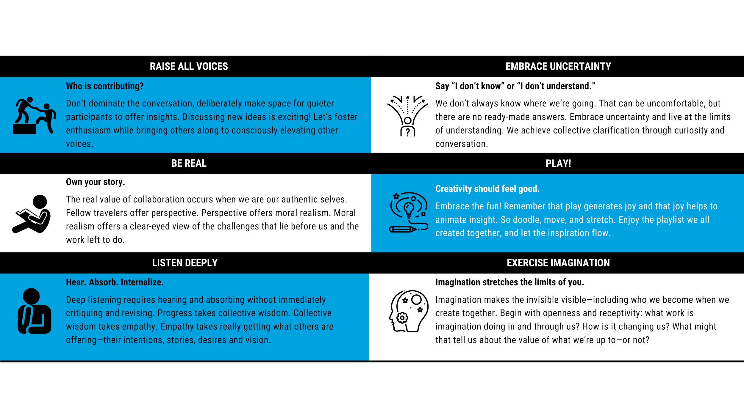

Slide 12
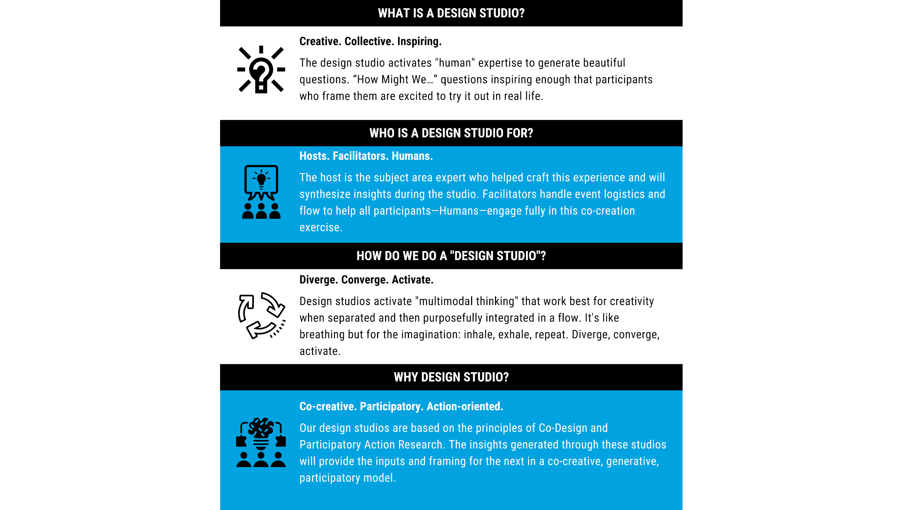

Slide 13
Prelude

Slide 14
Why this
design studio?

Slide 15
Movement #1

Slide 16


Use 2 Thinking Modes: Diverge then Converge
When you are generating ideas with your group, please use these 2 distinct thinking modes, in this order.
First Diverge: get all of your ideas out individually.
Then Converge: review what you have, find patterns and see what is emerging then discuss and make decisions.
Diverge
No judgement
Go for quantity!
“Yes, and…”
Be bold!
Converge
Strategic judgement
Go for quality!
Praise first
Be bold!

Slide 17
“How has your experience of work changed since the beginning of the pandemic?”

Slide 18
Breakout Room 1
How has work changed?
Breakout room agenda
4 minutes diverge.
4 minutes converge.
Choose a reporter.
Breakout Room 1
Facilitator: Erica O’Neil
Timekeeper: Adrianna Matthews
Barry Brown
Irasema Coronado
Ian Bogost
Dédé Tetsubayashi
Notes:
(8 mins) Breakout Groups, 4 minutes diverge each human has 1 minute, 4 minutes converge
(5 mins) Group reporting - 1 minute per group
(5 mins) Respondent: Katina

Slide 19
Movement 1, Breakout Group 1:
“How has your experience of work changed since the beginning of the pandemic?”
STEP 1: DIVERGE [4 minutes]
Each person share your response to the question above. All voices heard! The notetaker will add your responses to the sticky notes below.
STEP 2: CONVERGE [4 minutes]
Begin to suggest themes for Big Ideas that are emerging. The notetaker will add them to the blue sticky notes below.
Uncertainty bleeds into relationship with non-work (food, caregiving)
Invasion of compartments of life, pervasive, heavy
Teaching adaptation to technology
Workspace in home, bringing work home
Familial adaptations: telemedicine
Time found: Commute and parking
Knowledge work and privilege
Familial constraints/duties
New relationship time/boundaries: Accessibility and scheduling self
Booking time for zoom/self: Zoom fatigue is real
Can’t protect calendar. Mismatch between self-company
Does constant availability = constant productivity?
Burnout.
Not working from home, living at work
Not that much has changed for some knowledge workers
Acceleration.
Protective concerns around health =/= protective concerns around work
Salaried and caregiving work: Invisible work is more visible
Invasion of work with private life
How do I feed myself, when is time in the day?
Salaried work is caregiving work
Invasion of work and life.

Slide 20
Breakout Room 2
How has work changed?
Breakout room agenda
4 minutes diverge.
4 minutes converge.
Choose a reporter.
Breakout Room 2
Facilitator: Gaymon Bennett
Timekeeper: Taylor Genovese
Radha Mistry
Jeffrey Cohen
Christina Boyles
Robert Newman
Notes:
(8 mins) Breakout Groups, 4 minutes diverge each human has 1 minute, 4 minutes converge
(5 mins) Group reporting - 1 minute per group
(5 mins) Respondent: Katina

Slide 21
Movement 1, Breakout Group 2:
“How has your experience of work changed since the beginning of the pandemic?”
STEP 1: DIVERGE [4 minutes]
Each person share your response to the question above. All voices heard! The notetaker will add your responses to the sticky notes below.
STEP 2: CONVERGE [4 minutes]
Begin to suggest themes for Big Ideas that are emerging. The notetaker will add them to the blue sticky notes below.
Intensification.
Work becomes an escape.
Distribution of people
Scope of work has expanded
Difficulty in reading body language/
energy in the room
Learning to be gentle in our current situation(s)
Harder to read “energy in the room.”
More attention to emotional/body health
Checking in becomes a burden
Awareness of health is intensified, but so is escape.
Learning to become (more) adaptable.
More structured.
More attention to safety and health.
Entirely work from home.
Additional family care obligations.
Intensity is a spectrum.
Lack of training on becoming adaptable.
Less spontaneity.
Additional external responsibilities
Self-care emphasized.

Slide 22
Breakout Room 3
How has work changed?
Breakout room agenda
4 minutes diverge.
4 minutes converge.
Choose a reporter.
Breakout Room 3
Facilitator: Elizabeth Langland
Timekeeper: Tori Vandekop
Nathan Shedroff
Ayanna Thompson
Purdom Lindblad
David Kirkpatrick
Notes:
(8 mins) Breakout Groups, 4 minutes diverge each human has 1 minute, 4 minutes converge
(5 mins) Group reporting - 1 minute per group
(5 mins) Respondent: Katina

Slide 23
Movement 1, Breakout Group 3:
“How has your experience of work changed since the beginning of the pandemic?”
STEP 1: DIVERGE [4 minutes]
Each person share your response to the question above. All voices heard! The notetaker will add your responses to the sticky notes below.
STEP 2: CONVERGE [4 minutes]
Begin to suggest themes for Big Ideas that are emerging. The notetaker will add them to the blue sticky notes below.
A sense of community has changed
Lack of shared sense of place
Isolation leads to feeling of peace in not having to move so much
Balancing work with being a support staff for 4th grade
Sense of place is shifting, both negative and positive
Feelings about productivity can be both positive and negative with working from home
There’s a cohesion that is missing
More distraction
People are working less, get same amount done in shorter time
“It’s okay to not be on your comp. all the time” its ok to go outside
There is an ease that’s missing from our work lives
So many people without jobs
Time to do more of what I want to do
Material deliverables have been very fluid, feel like I’ve done a lot of work
This period hasn’t been what anyone of us expected
Type a THEME here
We have to be more focused on the tech comm
Feelings of isolation
Zoom is pretty miraculous to come at this time
Type text here.

Slide 24
Breakout Room 4
How has work changed?
Breakout room agenda
4 minutes diverge.
4 minutes converge.
Choose a reporter.
Breakout Room 4
Facilitator: Tamara Christensen
Timekeeper: Sean Kenney
Teddy Zmrhal
Pardis Mahdavi
Marcel O’Gorman
Rosemarie Garland-Thomson
Notes:
(8 mins) Breakout Groups, 4 minutes diverge each human has 1 minute, 4 minutes converge
(5 mins) Group reporting - 1 minute per group
(5 mins) Respondent: Katina

Slide 25
Movement 1, Breakout Group 4:
“How has your experience of work changed since the beginning of the pandemic?”
STEP 1: DIVERGE [4 minutes]
Each person share your response to the question above. All voices heard! The notetaker will add your responses to the sticky notes below.
STEP 2: CONVERGE [4 minutes]
Begin to suggest themes for Big Ideas that are emerging. The notetaker will add them to the blue sticky notes below.
Must introduce, “announce” self differently, compared to in person
Dynamics of recognition are changed, working together digital v in person
Extra Disability challenges, machines required
Fraught relationships with normalizing tech
Voice and Representation
Pain
Pace: slow down or speed up.
Do more, take on more, do it over and over
Fatigue leads to trying new things
Family and work responsibilities
Captivated by western protestant culture of work
Holding space, and trying to slow down
Mediating tension
Personal loss, collapse of work and life
Pace
Presentation
Bring work to community, social networks
Do more relevant work
Compensating for overwhelmed others whom we feel responsible for, then creating more overwhelm for ourselves
Type text here.

Slide 26
Host Remarks

Slide 27
Movement #2

Slide 28
Listen with your whole body.
Notes:
Dystopia: https://youtu.be/i3RVjFSxfrI?t=77
Tranquility: https://youtu.be/jumIdPtZq7I?t=81

Slide 29
“If our relation to work stays on the
same trajectory,
where might we end up?”

Slide 30
Use 2 Thinking Modes: Diverge then Converge
When you are generating ideas with your group, please use these 2 distinct thinking modes, in this order.
First Diverge: get all of your ideas out individually.
Then Converge: review what you have, find patterns and see what is emerging then discuss and make decisions.
Diverge
No judgement
Go for quantity!
“Yes, and…”
Be bold!
Converge
Strategic judgement
Go for quality!
Praise first
Be bold!

Slide 31
Breakout Room 1
Where might we end up?
Breakout room agenda
4 minutes diverge.
4 minutes converge.
Choose a reporter.
Breakout Room 1
Facilitator: Erica O’Neil
Timekeeper: Adrianna Matthews
Barry Brown
Irasema Coronado
Ian Bogost
Dédé Tetsubayashi
Notes:
(8 mins) Breakout Groups, 4 minutes diverge each human has 1 minute, 4 minutes converge
(5 mins) Group reporting - 1 minute per group
(5 mins) Respondent: Katina

Slide 32
Movement 2, Breakout Group 1:
“If we keep on the same trajectory, where might we end up?”
STEP 1: DIVERGE [4 minutes]
Each person share your response to the question above. All voices heard! The notetaker will add your responses to the sticky notes below.
STEP 2: CONVERGE [4 minutes]
Begin to suggest themes for Big Ideas that are emerging. The notetaker will add them to the blue sticky notes below.
Utopia for who?
Dystopia
Lost year of children’s learning
Digital divide and gap stark
Digital divide exacerbates socioeconomic divide, resource allocation mismatched
New definition of essential worker, but class divide amplified in reward of being “essential”
Alienation of those close to us
Benefits of digital format for reaching out from afar
Socioeconomic strata and divide
Technological wedge
Burn out in this digital environment
Travel less, conference schedule changes
Is digital connection realconnection?
Thriving in this digital environment
Results in increased: Social strife, conflict, divide
Amplification of ills of end stage capitalism, more dependence on exploitative labor force
Split between personal life and work accomplishment
Lack of community: doesn’t give back parts of ourselves
Societal divide between digital and analog
Gap between global north and south

Slide 33
Breakout Room 2
Where might we end up?
Breakout room agenda
4 minutes diverge.
4 minutes converge.
Choose a reporter.
Breakout Room 2
Facilitator: Gaymon Bennett
Timekeeper: Taylor Genovese
Radha Mistry
Jeffrey Cohen
Christina Boyles
Robert Newman
Notes:
(8 mins) Breakout Groups, 4 minutes diverge each human has 1 minute, 4 minutes converge
(5 mins) Group reporting - 1 minute per group
(5 mins) Respondent: Katina

Slide 34
Movement 2, Breakout Group 2:
“If we keep on the same trajectory, where might we end up?”
STEP 1: DIVERGE [4 minutes]
Each person share your response to the question above. All voices heard! The notetaker will add your responses to the sticky notes below.
STEP 2: CONVERGE [4 minutes]
Begin to suggest themes for Big Ideas that are emerging. The notetaker will add them to the blue sticky notes below.
Shifting spectrum between isolation/
connectedness
Offsetting work schedules.
More mechanistic or more tranquil?
Intensification of negotiating the “home experience.”
Negotiating home/work experience.
More flexibility and moments of tranquility.
Productivity not rooted in temporality.
Negotiating space, time, relationships.
More intentional about setting space/time.
Redefine what it means to be connected.
Where/how we will learn from each other?
Learning to exist without spontaneity.
Flexibility can break us free of 9-5 mold.
Curating work and tension at home/work clashing.
Modeling/teaching boundaries in home/work.
Move toward tech providing solutions.
Negotiating home/work space.

Slide 35
Breakout Room 3
Where might we end up?
Breakout room agenda
4 minutes diverge.
4 minutes converge.
Choose a reporter.
Breakout Room 3
Facilitator: Elizabeth Langland
Timekeeper: Tori Vandekop
Nathan Shedroff
Ayanna Thompson
Purdom Lindblad
David Kirkpatrick
Notes:
(8 mins) Breakout Groups, 4 minutes diverge each human has 1 minute, 4 minutes converge
(5 mins) Group reporting - 1 minute per group
(5 mins) Respondent: Katina

Slide 36
Movement 2, Breakout Group 3:
“If we keep on the same trajectory, where might we end up?”
STEP 1: DIVERGE [4 minutes]
Each person share your response to the question above. All voices heard! The notetaker will add your responses to the sticky notes below.
STEP 2: CONVERGE [4 minutes]
Begin to suggest themes for Big Ideas that are emerging. The notetaker will add them to the blue sticky notes below.
Thinking about the future of work is hard to imagine when all days see the same
Return to gratitude
Amplifying the inequities we had before
Type text here.
Work life balance
Dialogue about essential workers have been healthy
The presence of tech in our lives is out of control, both personal and societal level, not sustainable
When do we employ tech to tell certain stories, and when are stories not meant to be told outside a a group
Type text here.
Type text here.
Increasingly divided
Need a new boundary between us and tech
If we don’t find a boundary between tech and our lives, our lives will be worse
Who has the microphone to tell their own story, who doesn’t.
Type text here.
Type text here.
Tech needs to be more humanely designed
Distinction between types of people, nurses, unemployed, virtual teachers, parents with more responsibilities
Work has often been balancing the playing field
Type text here.
Type text here.

Slide 37
Breakout Room 4
Where might we end up?
Breakout room agenda
4 minutes diverge.
4 minutes converge.
Choose a reporter.
Breakout Room 4
Facilitator: Tamara Christensen
Timekeeper: Sean Kenney
Teddy Zmrhal
Pardis Mahdavi
Marcel O’Gorman
Rosemarie Garland-Thomson
Notes:
(8 mins) Breakout Groups, 4 minutes diverge each human has 1 minute, 4 minutes converge
(5 mins) Group reporting - 1 minute per group
(5 mins) Respondent: Katina

Slide 38
Movement 2, Breakout Group 4:
“If we keep on the same trajectory, where might we end up?”
STEP 1: DIVERGE [4 minutes]
Each person share your response to the question above. All voices heard! The notetaker will add your responses to the sticky notes below.
STEP 2: CONVERGE [4 minutes]
Begin to suggest themes for Big Ideas that are emerging. The notetaker will add them to the blue sticky notes below.
Mental Health Issues
Recognition by others virtually
Disenchantment
Disassociation with others
Disenchantment
Disembodiment
Disembodied, no longer a whole person
Hope for integration
Time, relationship with time
Changing integrations with family, work
New different culture of work
Not constantly connected, available at all times
Less acceptance of life, kids, etc.
Patience and etiquette have changed
Disassociation
Need to intentionally change work life balance
Tools have damaged humans, historically
Humans make tools, that hurt us
Work tools are hurting in new ways

Slide 39
Host Remarks

Slide 40
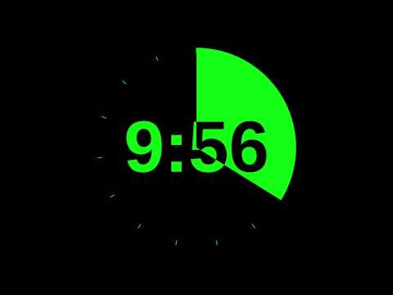
Break

Slide 41
Movement #3

Slide 42
“What would you change about the trajectory of the future of work,
and why?”

Slide 43
Breakout Room 1
How do we change?
Breakout room agenda
10 mins, generate “How might we…” questions.
Choose the most inspiring.
Choose a reporter.
Breakout Room 1
Facilitator: Erica O’Neil
Timekeeper: Adrianna Matthews
Barry Brown
Irasema Coronado
Ian Bogost
Dédé Tetsubayashi
Notes:
(8 mins) Breakout Groups, 4 minutes diverge each human has 1 minute, 4 minutes converge
(5 mins) Group reporting - 1 minute per group
(5 mins) Respondent: Katina

Slide 44
Movement 3, Breakout Group 1:
“What would you change about the trajectory of the future of work, and why?”
How might we envision a future when universal basic income provides?
How might we realign the monetary reward of work to reflect contributions to society?
STEP 1: DIVERGE [4 minutes]
Each person share your response to the question above. All voices heard! The notetaker will add your responses to the sticky notes below.
STEP 2: CONVERGE [4 minutes]
Begin to suggest themes for Big Ideas that are emerging. The notetaker will add them to the blue sticky notes below.
How might we work less?
How might we not work at all?
How might we work less?
How might we protect our personal time?
How might we disengage with technology?
How might we include those without the option to disentangle from tech?
How might we make work more equitable and just for everyone?
How might we make work more meaningful for all?
How might we reward “essential” workers as “essential” to economy?
How might we integrate our values in work with values in life?
How might we work for a life well-lived?
How might we work toward meaning?
How might we redesign our world, our interactions, our work?
How might we redesign the reward system to prioritize our needs?
How might we make sure that nobody gets left behind in our future?
How might we redesign the capitalist system to account for change?
How might we redesign capitalism, or the reward structure of work?
How might we design work that leads us to community?
How might we redesign capitalist “limitless abundance”?
How might we redesign social safety net and connection to work?
How might we work disconnection into this?
How might we

Slide 45
Breakout Room 2
How do we change?
Breakout room agenda
10 mins, generate “How might we…” questions.
Choose the most inspiring.
Choose a reporter.
Breakout Room 2
Facilitator: Gaymon Bennett
Timekeeper: Taylor Genovese
Radha Mistry
Jeffrey Cohen
Christina Boyles
Robert Newman
Notes:
(8 mins) Breakout Groups, 4 minutes diverge each human has 1 minute, 4 minutes converge
(5 mins) Group reporting - 1 minute per group
(5 mins) Respondent: Katina

Slide 46
Movement 3, Breakout Group 2:
“What would you change about the trajectory of the future of work, and why?”
STEP 1: DIVERGE [4 minutes]
Each person share your response to the question above. All voices heard! The notetaker will add your responses to the sticky notes below.
STEP 2: CONVERGE [4 minutes]
Begin to suggest themes for Big Ideas that are emerging. The notetaker will add them to the blue sticky notes below.
Flip automation convo on its head
Think about behaviors/norms over tech
Relationships
What communities/students need.
Be intentional with our values in how we approach tech (and in how tech approaches us)
Question whether tech enhances our lives.
What do WE need as individuals.
Cultivate attention to things/slow down
Check out from tech
Take time to center oneself
What does work look like without tech?
Invert the order of the “who” question. Particularly with governance.
Shift value from efficiency to something else
Break free to Western ideas of progress
Lose colonial mindset in technology
Cultural considerations in tech production
Cultural considerations outside of Western ideas of tech/production/progress/efficiency
What would it look like if we started with the humane (Who is humane? Who is eligible? Who is this preferable for?) rather than the tech?

Slide 47
Breakout Room 3
How do we change?
Breakout room agenda
10 mins, generate “How might we…” questions.
Choose the most inspiring.
Choose a reporter.
Breakout Room 3
Facilitator: Elizabeth Langland
Timekeeper: Tori Vandekop
Nathan Shedroff
Ayanna Thompson
Purdom Lindblad
David Kirkpatrick
Notes:
(8 mins) Breakout Groups, 4 minutes diverge each human has 1 minute, 4 minutes converge
(5 mins) Group reporting - 1 minute per group
(5 mins) Respondent: Katina

Slide 48
Movement 3, Breakout Group 3:
“What would you change about the trajectory of the future of work, and why?”
STEP 1: DIVERGE [4 minutes]
Each person share your response to the question above. All voices heard! The notetaker will add your responses to the sticky notes below.
STEP 2: CONVERGE [4 minutes]
Begin to suggest themes for Big Ideas that are emerging. The notetaker will add them to the blue sticky notes below.
We need to change education, away from tech centricity
Education should be more focused on the process of learning instead of the end product
The future of everyone’s work experience if they have room to learn more critical thinking
How might we
How Might We recenter education on humanity and citizenship of the future?
How Might We uncover the ethics in the digital things we build?
Too much emphasis on STEM while increased jobs are lost to automation
The flexibility to break something, room to grow and acquire a new skill
How might we
How might we
How Might We think not of work but of people?
How Might We reframe “failure” for better learning?
We need to instead hone in on the skills of the future, liberal arts, communication
Dislike the phrase “The Future of Work”
How might we
How might we
How Might We make the systems around us more transparent?
How might we
Instead, we need to think about “The Future of People”
How might we
How might we

Slide 49
Breakout Room 4
How do we change?
Breakout room agenda
10 mins, generate “How might we…” questions.
Choose the most inspiring.
Choose a reporter.
Breakout Room 4
Facilitator: Tamara Christensen
Timekeeper: Sean Kenney
Teddy Zmrhal
Pardis Mahdavi
Marcel O’Gorman
Rosemarie Garland-Thomson
Notes:
(8 mins) Breakout Groups, 4 minutes diverge each human has 1 minute, 4 minutes converge
(5 mins) Group reporting - 1 minute per group
(5 mins) Respondent: Katina

Slide 50
Movement 3, Breakout Group 4:
“What would you change about the trajectory of the future of work, and why?”
STEP 1: DIVERGE [4 minutes]
Each person share your response to the question above. All voices heard! The notetaker will add your responses to the sticky notes below.
STEP 2: CONVERGE [4 minutes]
Begin to suggest themes for Big Ideas that are emerging. The notetaker will add them to the blue sticky notes below.
How Might We...reimagine, reframe, and re-animalize the future of work work and raise awareness of our socialness?
How might we reimagine a future of work?
How might we think about flexibility?
How might we hybridize work?
How might we reimagine the future of work, including diverse jobs?
How might we reframe the meaning of work to not only include white collar work?
How might we think differently about flexibility FROM thetech?
How might we build awareness about the limits of being human?
How might we refrain from acting like a machine and more like a human?
How Might We… achieve human solidarity amid human variation?
How might we raise awareness about our capacity to act like machines?
How might we work less like machines and more like enfleshed beings?
How might we work in a way that reminds us that we are animals?
How might we
How Might We… think about the triple pandemic of social justice, health and climate?
How might we experience the fleshiness of work?
How might we shift from human-centered towards humanS-centered or humanE-centered? Focus on relationships
How might we approach social-centered design?
How might we

Slide 51
Beautiful Questions
Breakout Room 1 “How might we design work that leads us to community?”
Breakout Room 2 “HMW…?”
“What would it look like if we started with the humane (What is humane? Who is eligible? Who is this preferable for?) rather than the tech?”
Breakout Room 3 “HMW....?”
Breakout Room 4 “HMW…reimagine, reframe, and re-animalize the future of work and raise awareness of our socialness?”

Slide 52
Host Remarks

Slide 53
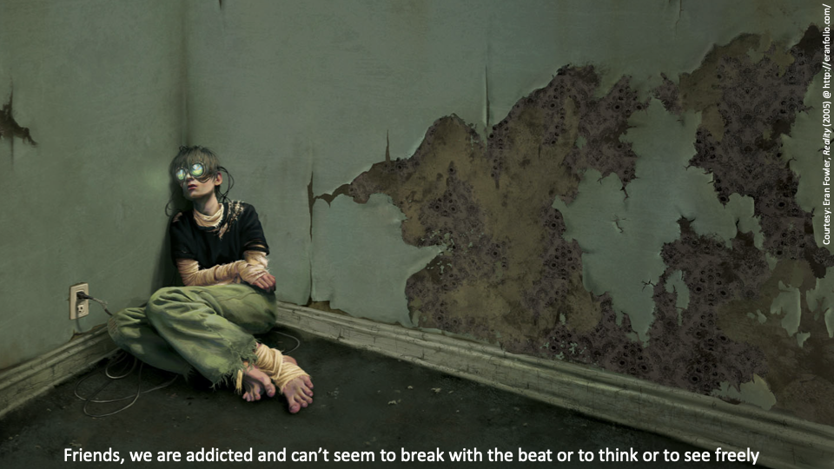

Slide 54
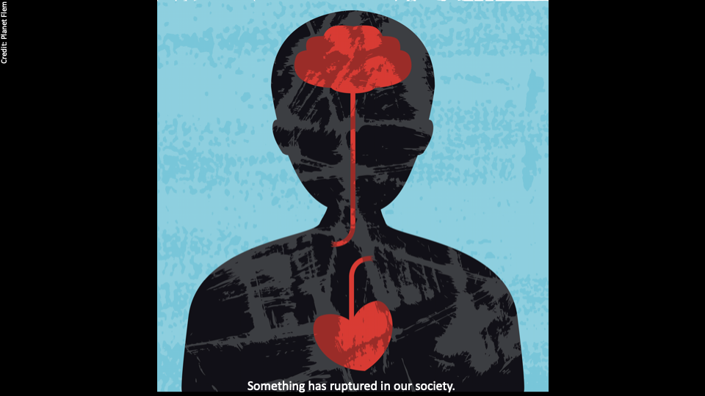

Slide 55
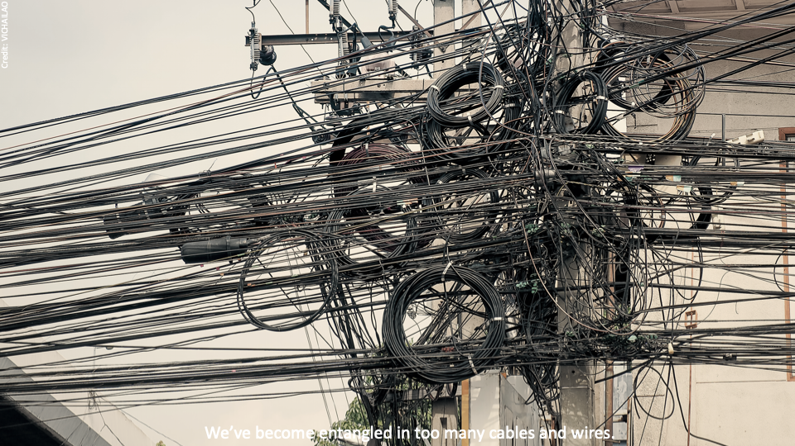

Slide 56
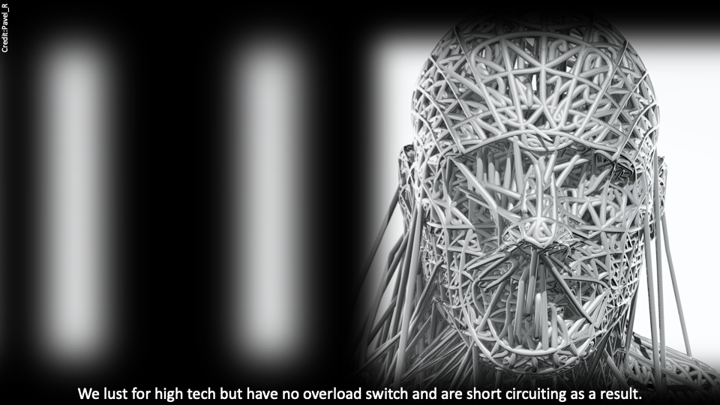

Slide 57
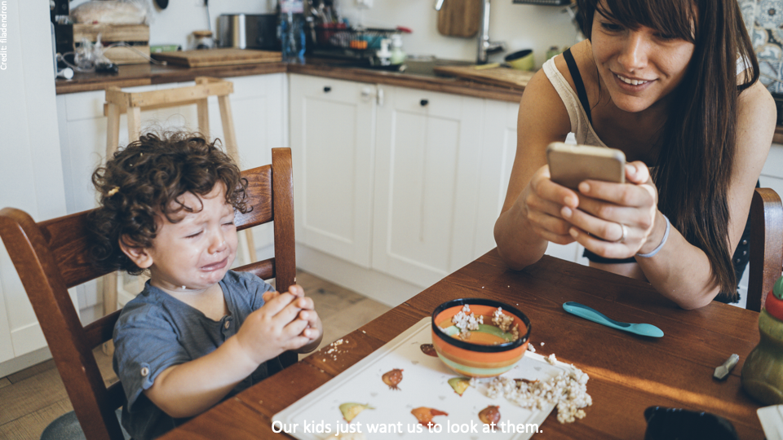

Slide 58
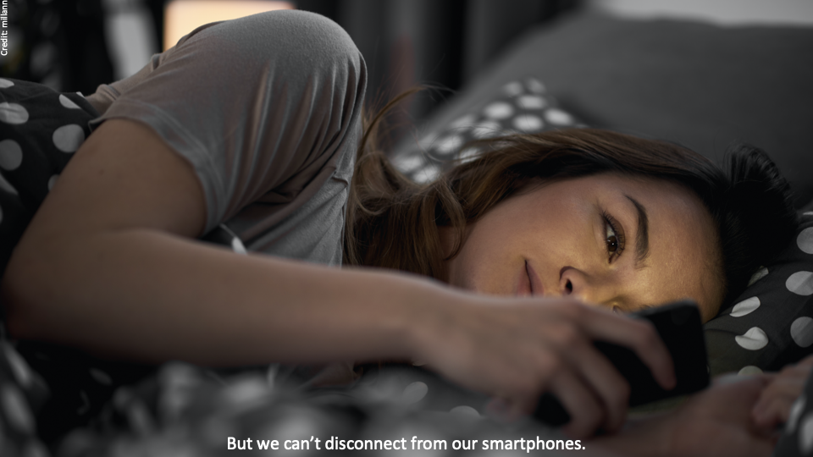

Slide 59
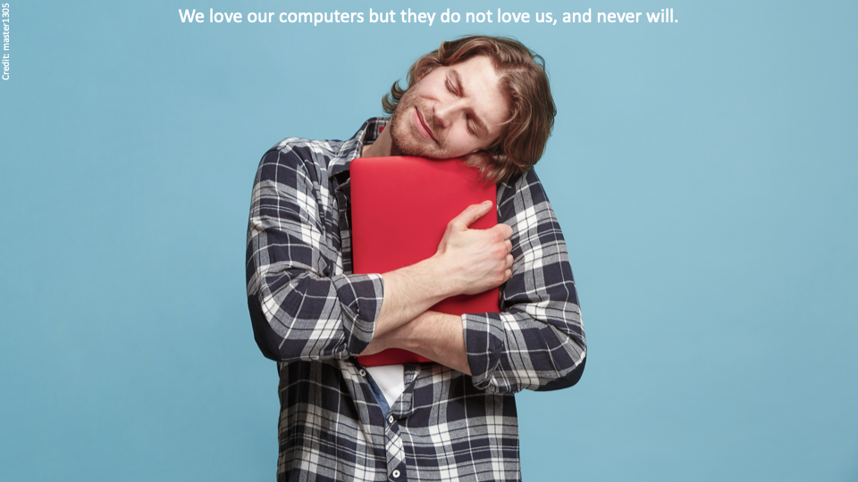

Slide 60
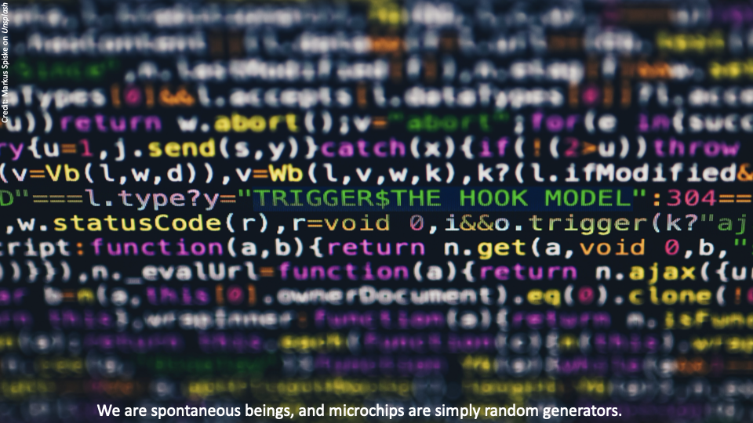

Slide 61
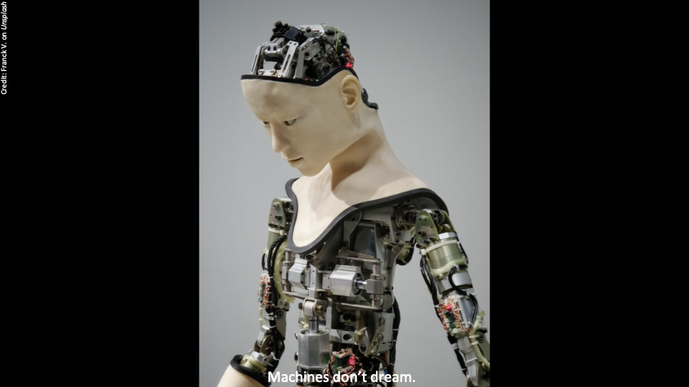

Slide 62
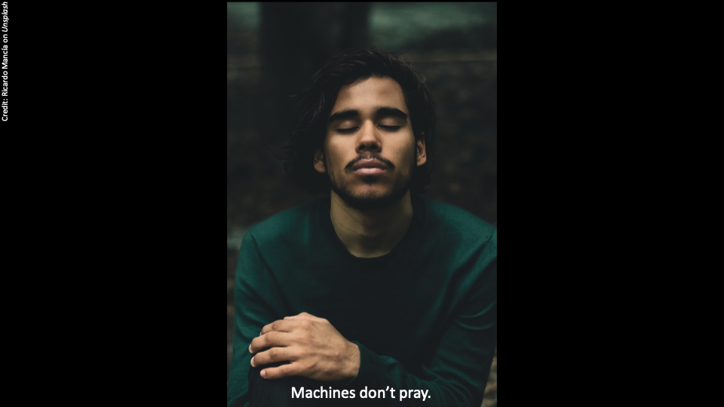

Slide 63
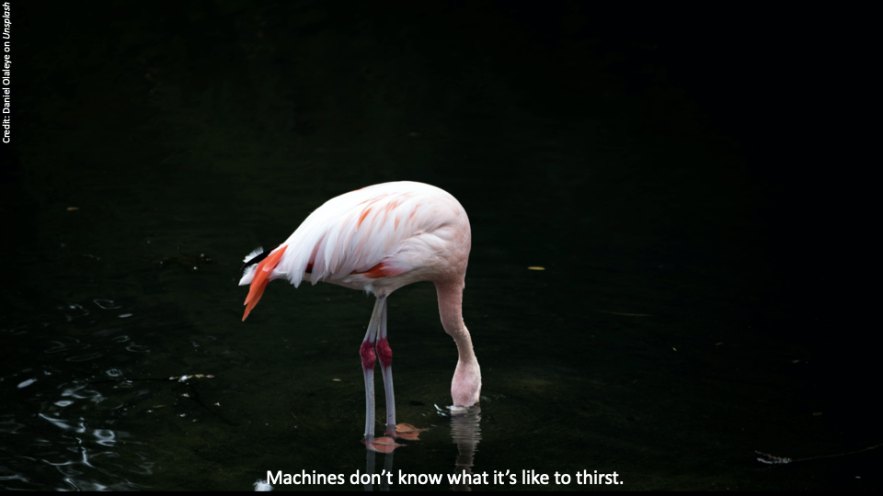

Slide 64
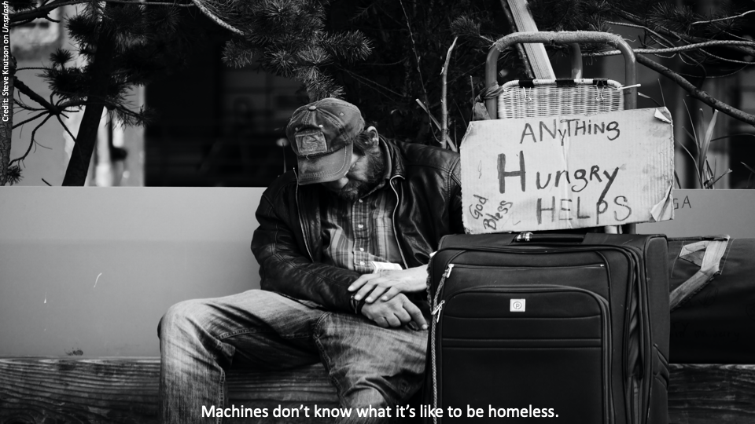

Slide 65
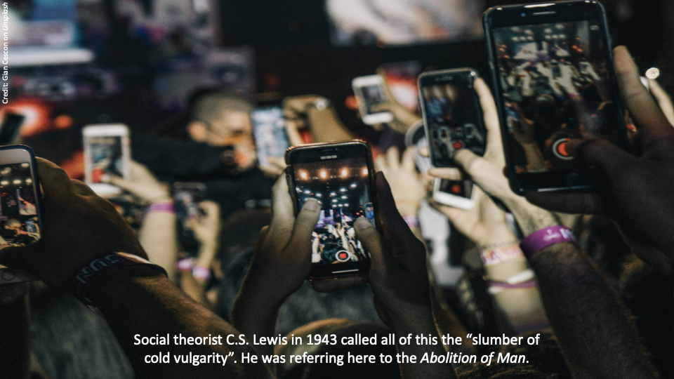

Slide 66
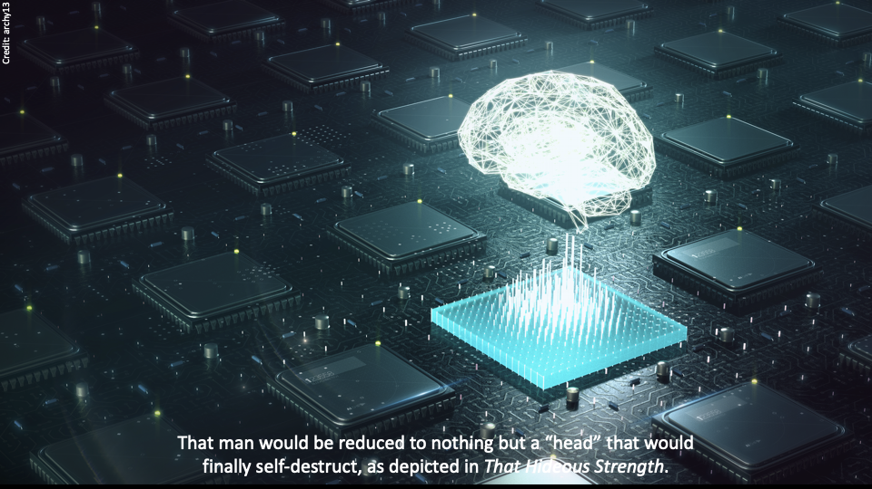

Slide 67
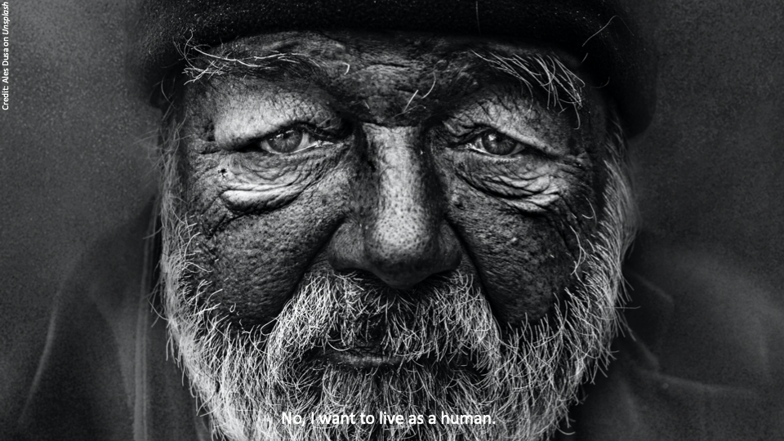

Slide 68
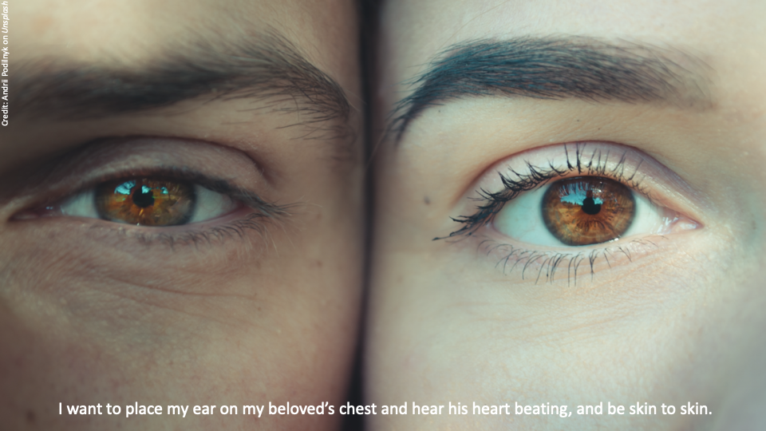

Slide 69
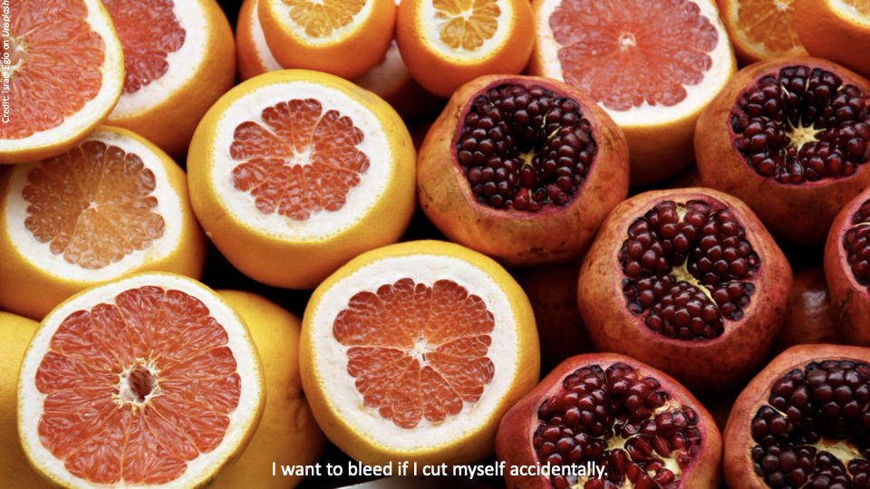

Slide 70
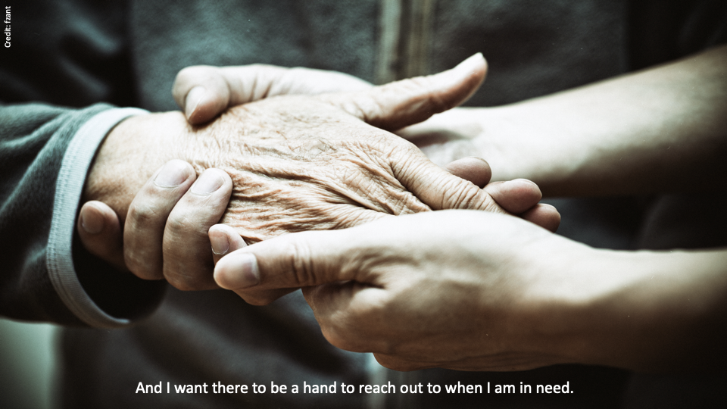

Slide 71
Final Thoughts

